Slide 1
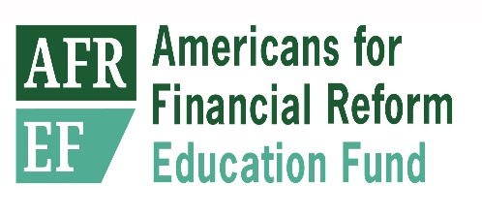
A Busy Year of Bank Deregulation
Initiative | Dates | Comments
Deregulating Superregional Banks | 4/2018 (Proposed) | Significant reductions in liquidity and stress testing requirements for dozens of banks over $50 billion; potential reductions in regulation for banks up to $700 billion in size. Goes beyond S. 2155 requirements.
Cutting Leverage Capital for Largest Banks | 4/2018 (Proposed) | Significant cuts in leverage capital requirements at the largest systemically important banks. Leverage capital requirements are the hardest for large banks to avoid.
Weakening Stress Tests for Large Banks | 4/2018 through 3/2019 (Now Final) | Eliminating leverage requirements in stress tests; eliminating qualitative testing of bank risk management; disclosure of key model elements.
Weakening the Volcker Rule | 7/2018 (Proposed) | Loosens controls on speculative trading by large banks, as well as fewer limits on bank investments.
Reduced Capital Requirements for Commercial Real Estate | 9/2018 (Proposed) | Required by S. 2155.
Cut In Capital Requirements for Bank Derivatives Dealers | 12/2018 (Proposed) | Changes in formula for derivatives risk significantly reduce capital held against derivatives positions.
Weakening Resolution Planning Requirements | 4/2019 (Proposed) | Reduces resolution planning requirements from annual to as little as one new plan every four to six years.
Cutting Capital Requirements for Large Custody Banks | 4/2019 (Proposed) | Required by S. 2155.
Weakening Derivatives Risk Management Safeguards | 5/2019 (Reported) | End risk-reducing margin requirements for derivatives transactions between affiliates of large complex banks.

Slide 2
Attacks on prudential supervision
Safety and soundness supervision was always seen as granting far-reaching discretionary powers.
  “’Safety and soundness’ is not hard-coded into law, reaches far beyond written rules, and crucially involves judgment in assessing whether a bank may be engaging in excessive risk”
Now this is under attack. Claim that discretionary supervisory decisions require formal rulemaking, that “guidance is not enforceable”, that supervisors are not free to require banks to manage risk.

Slide 3
What does the future hold?
Large bank leverage ratios have already begun to decline somewhat from their post-crisis peak.
  Tier 1 leverage at the largest banks has dropped from 9.1% in 2016 to 8.5% today.
Most new proposed banking rules have not yet been implemented, nor have industry efforts to restrain prudential supervision played out.
Deregulation is also taking place at market regulators and FSOC.

