Slide 1


Vermonters for a
New Economy
presents…
Public Banking
for Vermont

Slide 2
State Bank – Public Bank
We have a State Bank already. Loans and investment are made for business, students, housing, and municipal infrastructure.
  VEDA
  VSAC
  VHFA
  Bond Bank
Source of income for State of Vermont.
Keep Vermont’s money in Vermont.

Slide 3
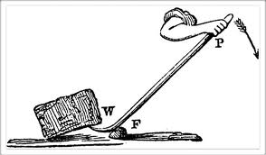
If VEDA were a real bank…
Capital could be leveraged 10 to 1.
Compare this to a revolving fund, where $100 can be lent only once and then must be repaid before relending.
$100 invested as capital in a bank can back $1,000 in loans.

Slide 4
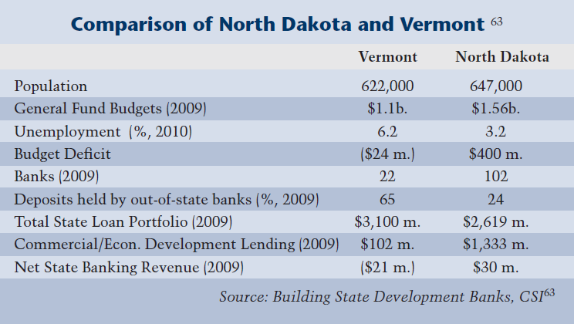
Two States, Similar Metrics

Slide 5
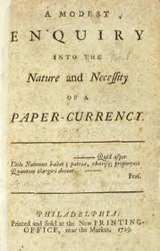
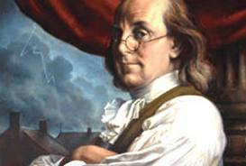
The original U.S. public bank model was in colonial Pennsylvania in Benjamin Franklin’s day.
Source: Ellen Brown, Public Banking Institute

Slide 6
In 1806, the Vermont legislature crated a State Bank
Governor Tichenor was initially opposed to the idea of a bank in VT and let the legislature know his feelings about banks:
“Banks, by facilitating enterprises both hazardous and unjustifiable, are natural sources of all that class of vices which arise from the gambling system and which cannot fail to act as sure and fatal, though slow, poisons to the republic in which they exist.”

Slide 7
Economic Impacts
If deposits of state cash funds were used for VEDA and VHFA loans, $236.2 million in public bank lending could result in:
• 2,535 new jobs
• $192 million in value added (Gross State Product)
• $342 million increase in state output

Slide 8
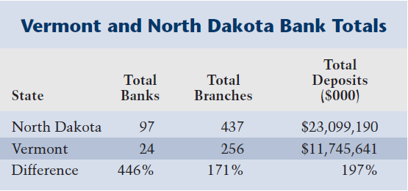
Healthy Banking Sector

Slide 9

The End?

