Slide 1
Modeling a State-Owned Public Bank Based on the Bank of North Dakota
Banking Without Wall Street Conference
May 27, 2014
Sam Munger, COWS, UW-Madison

Slide 2
Background on the Bank of North Dakota

Slide 3
The Bank of North Dakota
Formed in 1919 in response to the tightening of credit markets and agricultural crisis
BND Deposits
All state funds (state tax collections and fees, and for all funds of state institutions) are deposited with the Bank of North Dakota
  This does not include pension funds or other trusts managed by the state
Local governments may deposit funds at the bank but are not required to do so
Bank allowed to receive deposits from any source, including the United States government, individuals, corporations, and other entities
At the end of 2010, 86% of deposits from state & local government and less than 3% from private individuals and businesses

Slide 4
More on Deposits
Not a member of the FDIC and its deposits are not FDIC-insured
All deposits are guaranteed by the full faith and credit of the State of North Dakota
North Dakota law exempts all deposits from state, county, and municipal taxes

Slide 5
Bank of North Dakota
Use of Funds – Primary Lending Activities:
Involved in direct lending and participation loans, or loans made with another financial institution
Participant in secondary market for residential loans
Performs banker’s bank functions
Makes capital available to local banks via direct bank stock lending
Majority of lending is with in-state customers
Notes:
As the economic development bank of the state, it provides a variety of special lending programs:
Farm loan programs
Business financing programs
Small business development programs
New venture capital program
Community rural and regional development loan fund

Slide 6
BND Profits Returned to State
BND returns a portion of its profits to the state general fund
The size of this “state dividend,” is set by negotiation between the Legislature and the bank’s Governing Board
The amount has varied from year to year (from as little as 0 in some years to up to $50 million in others), but over the past 10 years has averaged $29.4 million (about 72% of bank profits) and totaled almost $300 million

Slide 7
The Bank of North Dakota Has Contributed to a Healthier Banking Sector in North Dakota

Slide 8
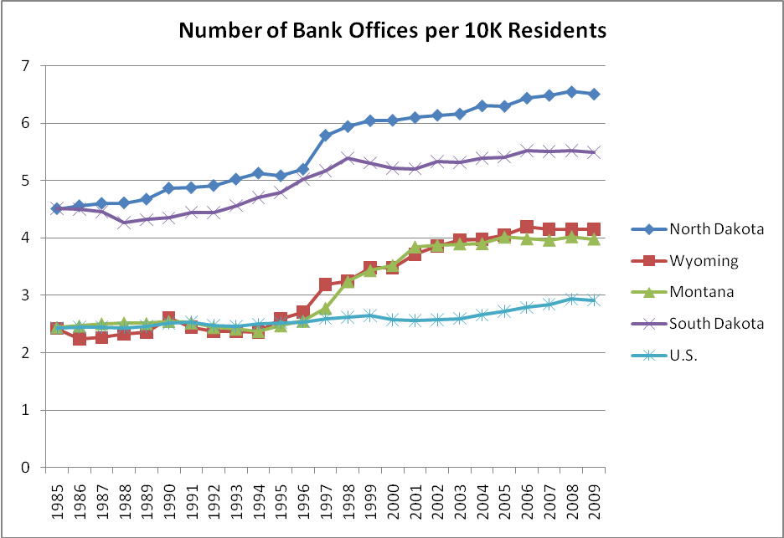
ND Banks Had More Offices Than Comparable States or the National Average

Slide 9
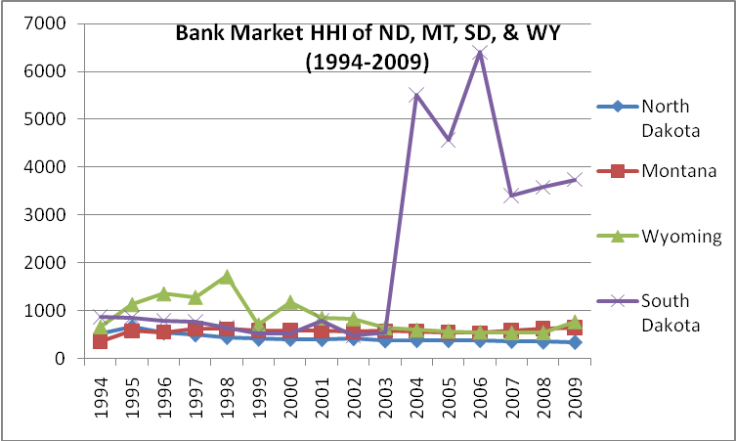
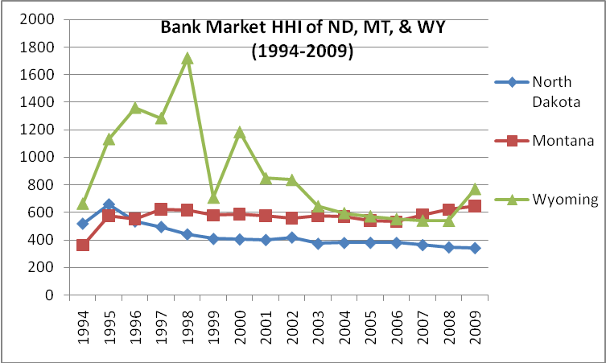
And Less Bank Market Concentration

Slide 10
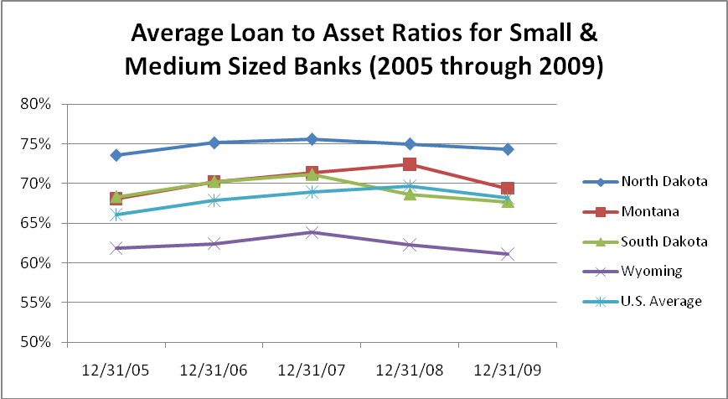
ND Banks Had Higher Loan to Asset Ratios
BND helped to sustain a loan to asset ratio for North Dakota banks – a key measure of direct economic impact – of roughly 4.4 to 12.4 percentage points greater than similarly-situated states

Slide 11
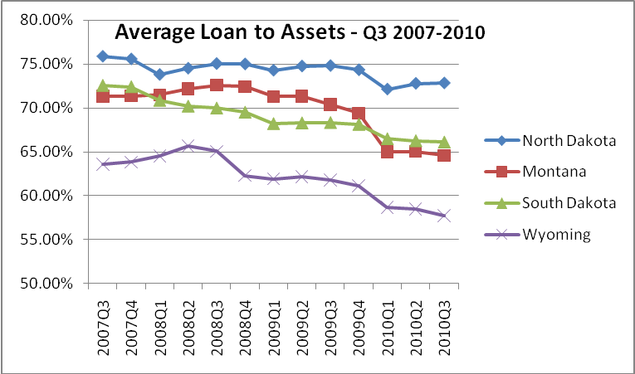
Less Decline in LTA During Recession
And loan to asset ratios in ND declined much less drastically as a result of the recession (which officially began in the 3rd quarter of 2007)

Slide 12
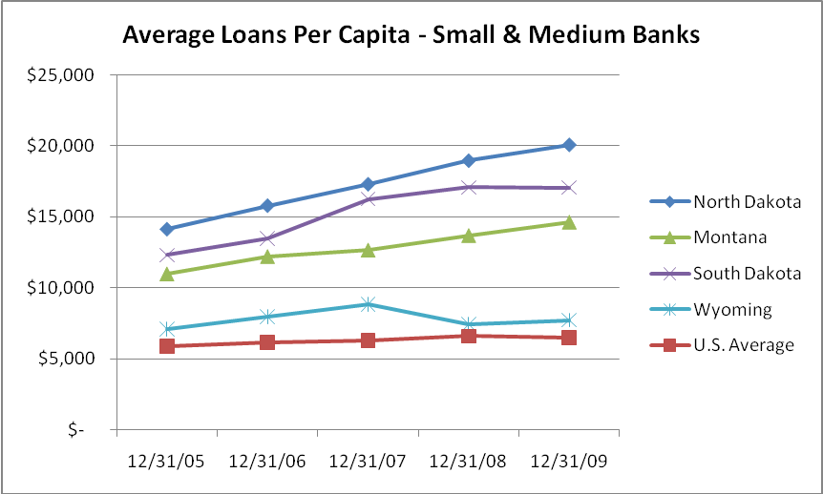
And Higher Average Loans Per Capita

Slide 13
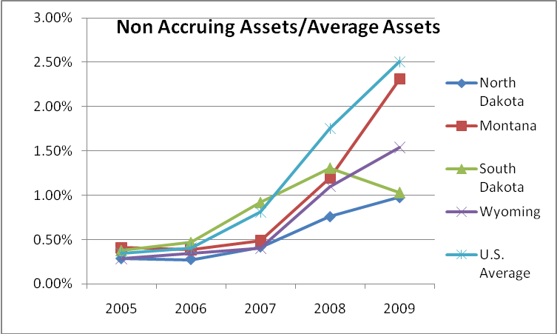
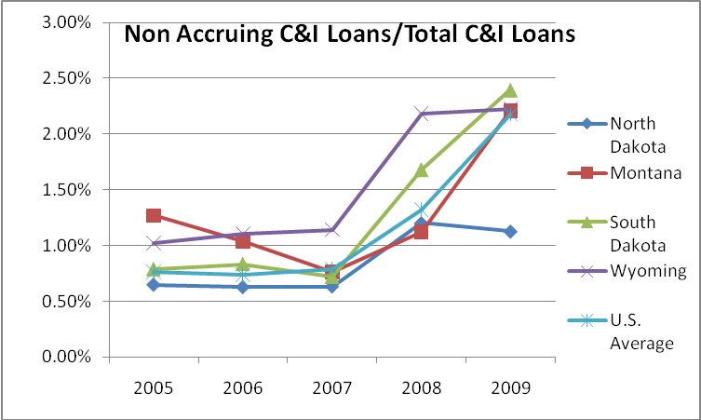
And Fewer Loans in Default, On Average

Slide 14
Modeling a State Bank in Other States (OR, WA, ME, MD, HI)

Slide 15
Example: Modeling an Oregon State Bank
Compares the fiscal health of North Dakota small and medium sized banks with the equivalent banks in the comparable states (based on geography, population size and density) of Montana, South Dakota, and Wyoming
Effect a state bank might have on the state banking industry by helping to provide liquidity and stability, using lending rates as a proxy
Effects of increase in lending rates on state job creation/retention
Estimates Bank ROA and returns to the state

Slide 16
L to A Ratios Between 4 and 12 Points Higher
BND helped to sustain a loan to asset ratio for North Dakota banks – a key measure of direct economic impact – of roughly 4.4 to 12.4 percentage points greater than similarly-situated states

Slide 17
Less Decline During Recession
And loan to asset ratios in ND declined much less drastically as a result of the recession (which officially began in the 3rd quarter of 2007)

Slide 18
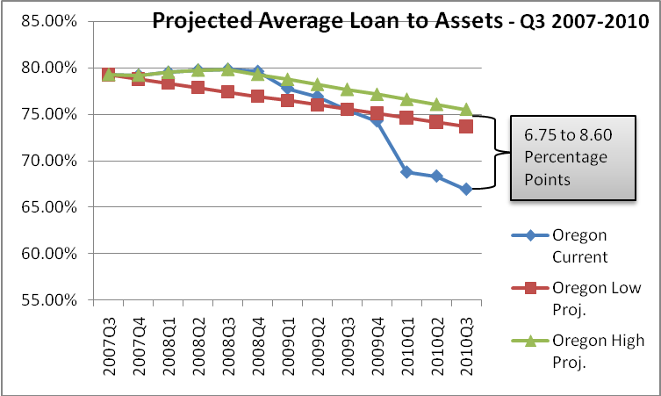
Less Decline During Recession
Imputing the slope of ND’s loan to asset ratio to Oregon, a state bank would have sustained loan to asset ratios 6 to 8 points higher

Slide 19
Key Effects – Increased Lending, Job Creation, Revenue to State

Slide 20
Oregon State Bank – Job Creation
A state bank could help create or retain an estimated 4,800-13,500 additional small business jobs in Oregon
An estimated 6,700 additional jobs would have been supported due to increased loan activity through bank participation loans from a state bank at full lending capacity

Slide 21
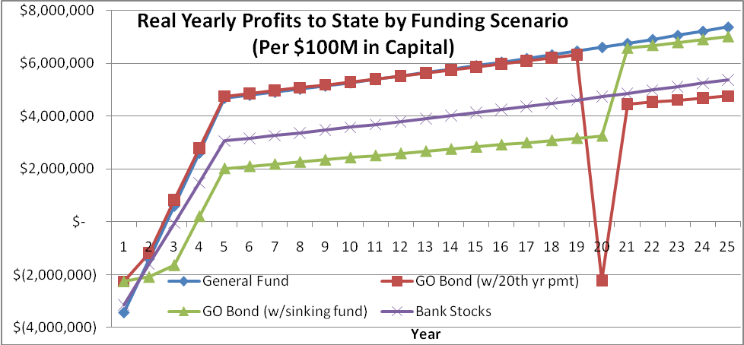
Oregon State Bank – Real Return to the State
An Oregon State Bank would have a positive Return on Equity (ROE) of real profits to the state within 4 years with prudent banking practices and a state dividend that returns at least 64% of state bank profits back to the state

Slide 22
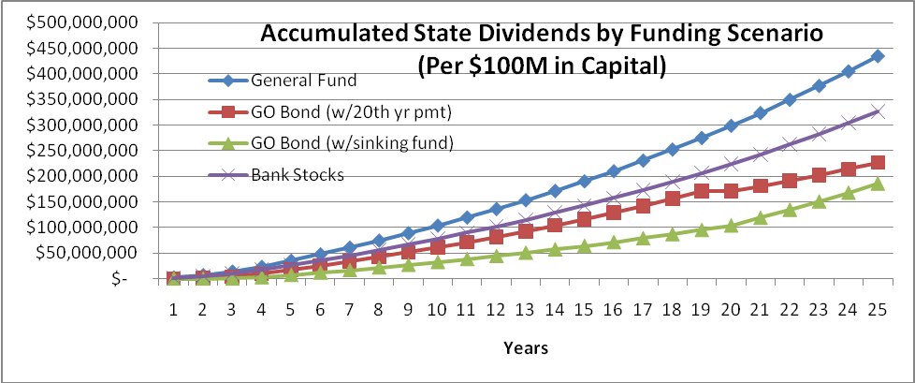
Oregon State Bank – New State Revenue
Oregon State Bank could generate dividends for the state starting in year 3
A bank capitalized at $200M could pay total accumulated dividends to the state’s General Fund of $65M after 10 years, $208M after 20 years, $579M after 30 years, and $1.16B after 40 years

Slide 23

alicelaw.org – mention model leg alice@alicelaw.org
Notes:
But remember that all that is the easy stuff, and that the real work, the interesting and exciting work, comes with picking up a pen or opening a laptop and learning how to draft a model bill, or how to make the policy case for one.
That’s the sort of work that will help build the strong progressive movement that we need in this country. That’s what we’re working on at ALICE, and we invite you to join us.
Thank you. Now let’s hear your questions.

Slide 24
Additional slides

Slide 25
BND Primary Lending Activity
Participates in loans originated by local banks and credit unions, either by increasing the total size of the loan, buying down the interest rate, or providing loan guarantees
Banker’s bank functions, including check clearing, bond accounting safekeeping, and providing fed funds lines with excess liquidity
Secondary market for residential loans
Direct lender for student loans
Makes capital available to local banks via direct bank stock lending, as well as by purchasing loans from their portfolios

Slide 26
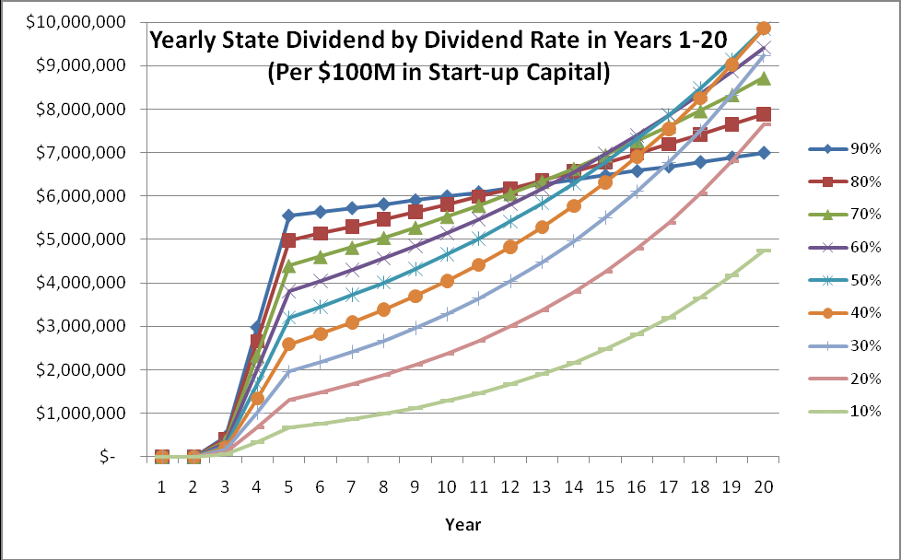
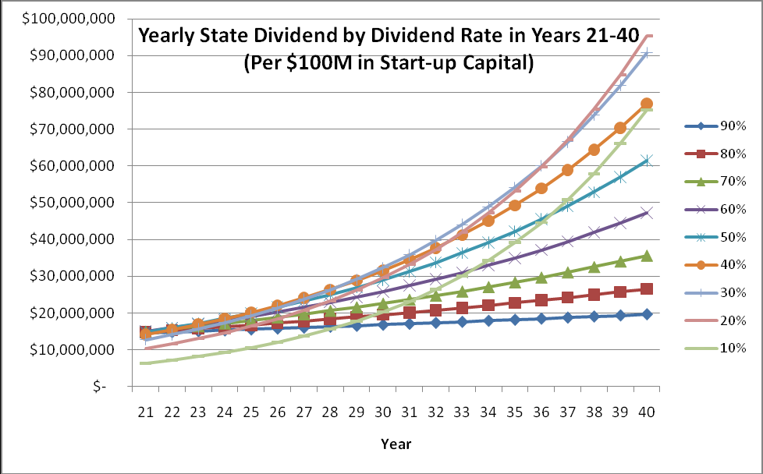
Yearly Return to State Would Ramp Up Gradually
By % of profits returned to state

Slide 27
Oregon State Bank – Fiscal Impact Calculator

Slide 28
BND Governance
BND is governed by the state Industrial Commission
Commission made up of the Governor, Attorney General and Commissioner of Agriculture
A seven-member Advisory Board, appointed by the Governor, reviews the Bank's operations and makes recommendations to the Industrial Commission relating to the Bank's management, services, policies and procedures

Slide 29
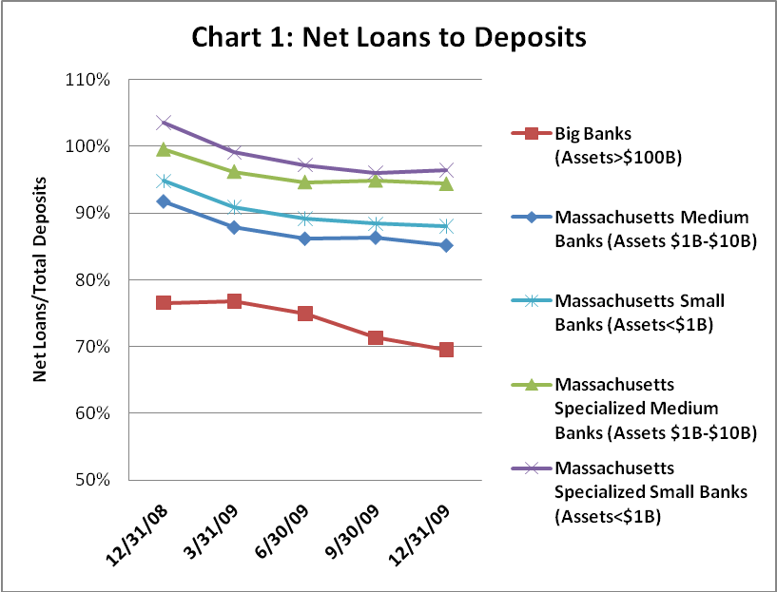
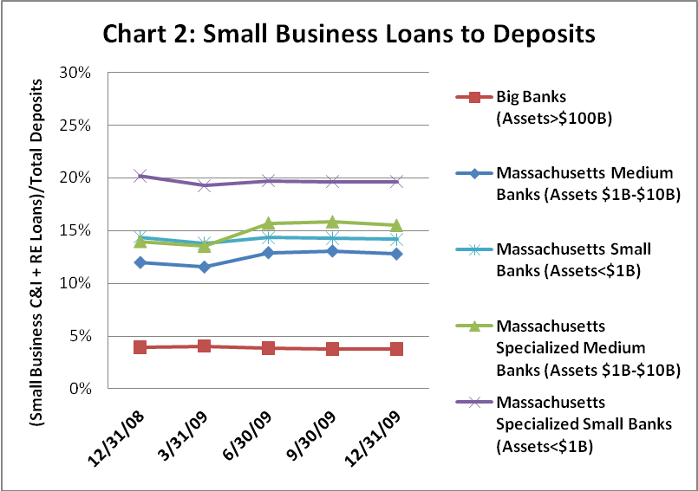
State Partnership Banks
“Move Your Money” - Small and medium sized banks generally lend at a higher rate and make a greater percentages of small business loans. For example:

Slide 30
Massachusetts Small Business Banking Partnership
Launched on May 5, 2011 by MA State Treasurer Steven Grossman
Invests state reserve funds into Massachusetts community banks with the understanding that the financial institutions will use the deposits to make new loans to small credit-worthy businesses to help them expand and create new jobs

Slide 31
Massachusetts Small Business Banking Partnership
Source of Funds:
$100 million in state deposits under the control of the Treasurer
Obtain competitive interest rates on the Commonwealth’s deposits
Require that all funds are insured or collateralized to ensure that there is no risk to the taxpayer’s money

Slide 32
Massachusetts Small Business Banking Partnership
Use of Funds:
Promote small business growth by providing creditworthy enterprises with greater access to loans
Provide capital support through cash deposits to banks with a strong record of small business lending
Banks commit to using funds to increase loans to creditworthy small businesses or for commercial loans of $500,000 or less
Banks make determinations of creditworthiness
Notes:
To qualify for the program, banks must:
Be on the list of banks approved to do business with the Commonwealth
Have a rating of at least “satisfactory” under Community Reinvestment Act
Be adequately capitalized

Slide 33
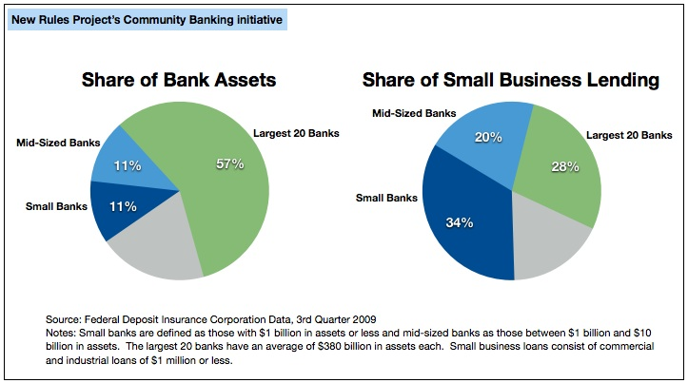
Big banks, small business

Slide 34
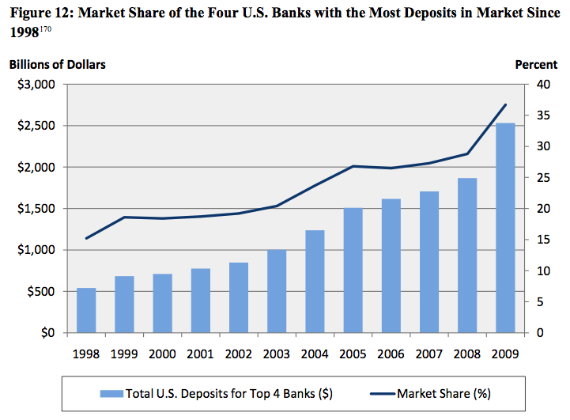
More powerful than ever

Slide 35
CA: bank consolidation

Slide 36
CA: BofA’s small business lending, 2005 - 09

Slide 37
Good policy, good politics
Q: The state of Maryland keeps billions in tax dollars in big out-of-state banks like Bank of America and M&T. Would you favor or oppose the state using these funds to create a public bank that will keep Maryland tax dollars at home, create more local jobs and support local banks that provide credit to small businesses in Maryland?
Strongly favor 43%
Somewhat favor 23%
Total favor 67%
Somewhat oppose 9%
Strongly oppose 10%
Total oppose 19%

Slide 38
AGENDA
Institutional and macroeconomic framework
II. Institutional design
III. BancoEstado: its financial inclusion strategy
IV. BancoEstado: its counter-cyclic strategy
Strategical guidelines 2012 -2014
Final reflexion

Slide 39
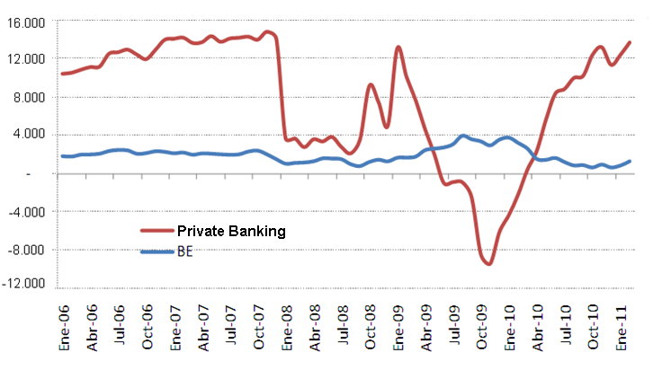
The “sudden stop” of private offer of credit
Counter-Cyclic Strategy: Base Diagnosis
Net Total Credit Flow Private Banking and BE (in MMUS$)

Slide 40
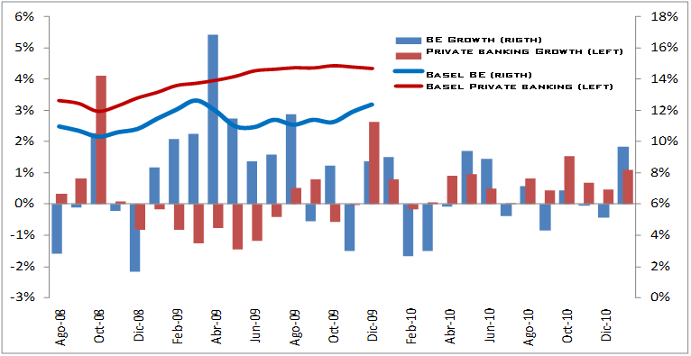
Counter-Cyclic Strategy: Capital Constraint
During capital constraint BE contributed to unlock the credit channel, while Private Banking increased capital gaps
Monthly real growth in bank credit and Basel Index
Source: SBIF
Notes:
40

Slide 41
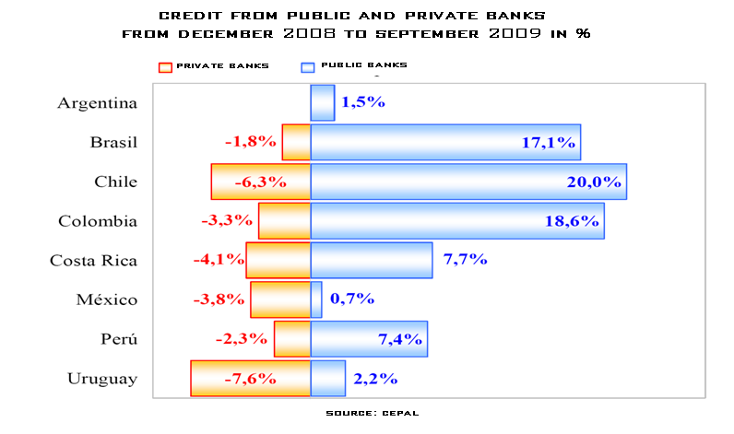
BE also acted in line with the regional public banks to keep lending channel transmission
Counter-Cyclic Strategy: Relative Momentum (I)

Slide 42
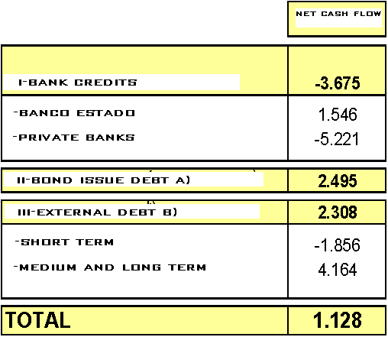
Counter-Cyclic Strategy: Relative Momentum (II)
Other internal and external credit suppliers validated the credit risk strategy of BE
Financiamiento Empresas
(flujos netos en millones de US$ a mayo 2009)
Corporative Bonds traded in Chile
(in Billion $)
A) Includes private and public companies debt
B) Includes short-term and long-term debt of non-financial companies plus accrued interest to April 2009
42
Notes:
42

Slide 43
Counter-Cyclic Strategy: Specific Actions
We design and apply an innovative strategy to address the uncertain economic situation
  Attractive credit offer at very competitive prices, anticipating even the Monetary Policy Rate reductions;
  Unique focus in loan growth;
  We provide financial support to viable businesses of all sizes and people of all levels;
  We work closely with customers by establishing alliances with real estate agents (72 hours) and unions;
  We use all available state guarantees, and
  We carry out campaigns, fairs and open on Saturdays

Slide 44
Counter-Cyclic Strategy: Overall goals
Strategic Priorities
  Increase credits in 11% ➔ additional offer of US$ 2.000 millons respect to 2008
  Increase our market share in 1%
  Maintain the level of credit risk under control via intensive relievers

Slide 45
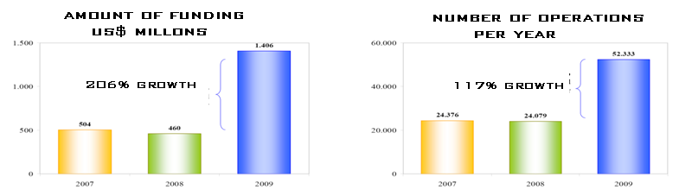
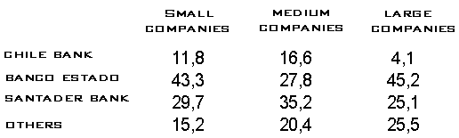
The “FOGAPE” Fund (Small business guarantee fund) grew at record level, led by BE
Counter-Cyclic Strategy: Credit guarantees for companies
Participation in number of operations, december 2009
Rebate in fees: 50%

Slide 46
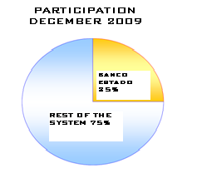
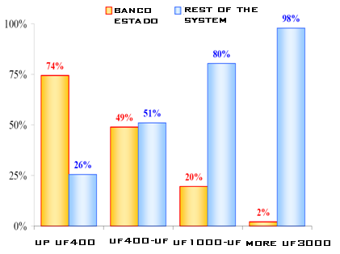
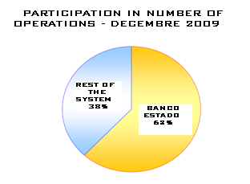
Counter-Cyclic Strategy: Home credit guarantees
Largest percentage of guarantees, grants offer, and lower prices resulted in an increase of demand for these loans, concentrating supply in small size ones
Participation by debt segment(%)

Slide 47

Counter-Cyclic Strategy: Signals to the market
We were aggressive in the supply of credit to SMEs and send clear signals to the competence

Slide 48
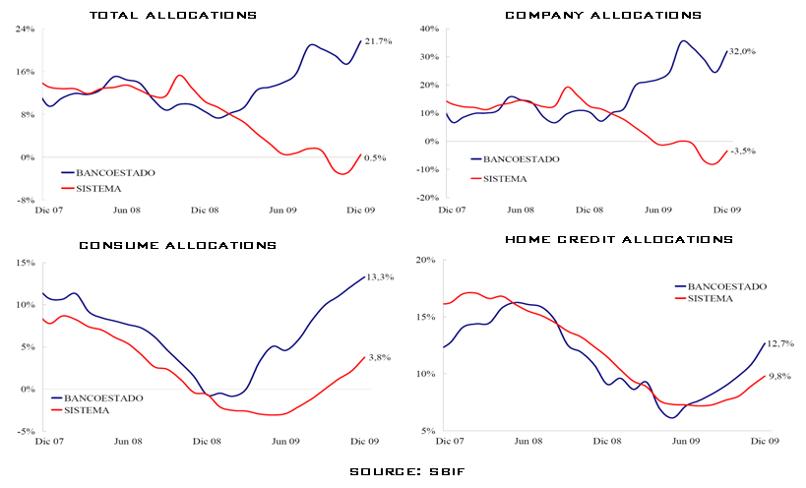
Counter-Cyclic supply in all the products……
Counter-Cyclic Strategy: Supply growth (I)

Slide 49
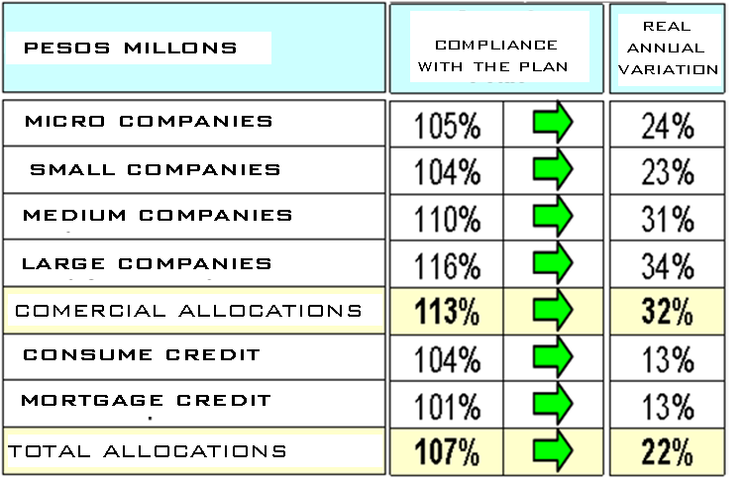
We met the growth targets in all segments
Counter-Cyclic Strategy: Supply growth (II)

Slide 50
Counter-Cyclic Strategy: Credit Risk
The maintenance of standards and use of guarantees keep risk under control
Loan loss provisions / Operational Income
(%)
Source: SBIF and BancoEstado

Slide 51
Counter-Cyclic Strategy: Profitability
Limited profitability sacrifice with high growth
ROE
(results / capital plus reservs)
Source: SBIF and BancoEstado

Slide 52
The Capital injection in BE helped ensure its solvency and boost lending channel
Counter-Cyclic Strategy: Solvency
Basel Index
Actualizar 2010 y 2011

Slide 53
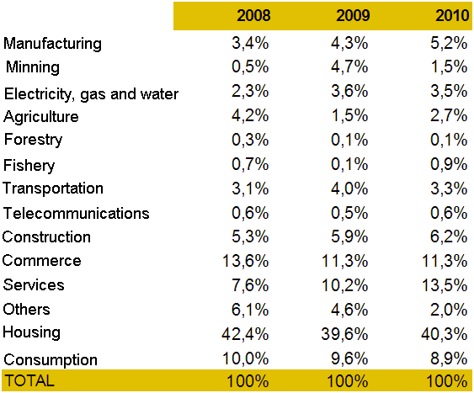
Counter-Cyclic Strategy
High historical importance of housing and the recent increase of Agriculture in BancoEstado portfolio
Credit Distribution by Economic Activity
(stocks in %)

