Slide 1

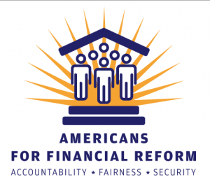
Americans for Financial Reform and the Center for Responsible Lending
Findings from a National Survey of 1,000 Likely 2014 Voters
Celinda Lake, David Mermin, and Liesl Newton
Washington, DC | Berkeley, CA | New York, NY
LakeResearch.com
202.776.9066

Slide 2
Methodology
Lake Research Partners designed and administered this survey that was conducted by telephone using professional interviewers between June 25-30, 2014. The survey reached a total of 1,000 likely 2014 voters nationwide.
Telephone numbers for the survey were drawn randomly from a voter file. The sample was stratified geographically based on the proportion of voters in each region. The data were weighted by gender, race, age, party identification, education level, and region.
The margin of error for this survey is +/- 3.1%.

Slide 3
Executive Summary
Voters continue to offer broad and deep support for oversight and regulation of the financial industry.
  93% agree that is is important to regulate financial products to make sure they are fair to consumers, 78% think there should be tougher rules and enforcement for financial companies, and two-thirds agree there should be more federal oversight of financial companies.
Voters are also broadly supportive of a wide range of reforms to protect consumers from unfair financial practices.
Although voters’ level of concern about these issues has dipped slightly since last year—probably as a result of less media coverage—concerns about the financial industry and support for reform remain strong across party lines.
Although over two-fifths do not have an impression of the CFPB, those who do rate it favorably by a 4:1 margin.
  Support for the CFPB increases to 75% after voters hear a description of its purpose.

Slide 4
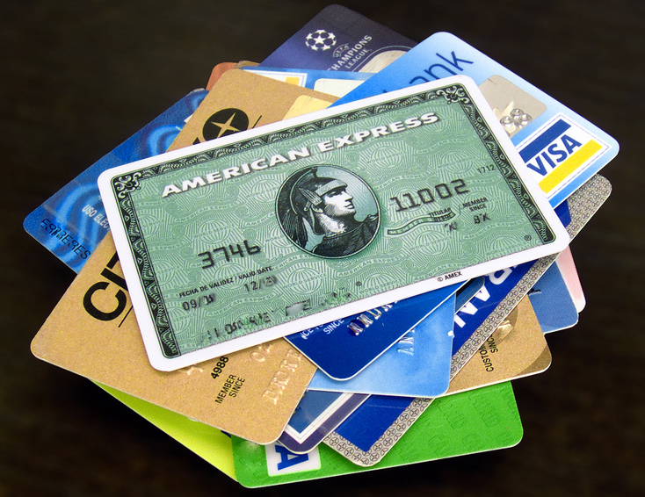
Lay of the Land

Slide 5
Strong majorities of voters have favorable impressions of credit unions and community banks, while they are net negative toward big banks and Wall Street financial companies. They have mixed feelings toward the financial industry as a whole.
Net | NO/NH
+75 | 10
+75 | 10
+77 | 11
+75 | 14
+1 | 13
+4 | 17
-7 | 9
-3 | 12
-24 | 21
-18 | 23
Unfavorable
Favorable
Darker colors indicate intensity.
Now I'd like to ask you about some people, groups, and products. For each, please tell me whether you have a very favorable, somewhat favorable, somewhat unfavorable, or very unfavorable impression. If you haven't heard of {6}, or if you don't know enough about that person, group, or product to have an impression {5}, just say so and we will move on.
[READ NAME.] Do you have a very favorable, somewhat favorable, somewhat unfavorable, or very unfavorable impression of [NAME]?

Slide 6
Both the FDIC and the CFPB receive positive ratings from voters, but the CFPB is less well-known.
Net | NO/NH
+57 | 19
+55 | 22
+39 | 37
+36 | 42
+26 | 39
+20 | 48
Unfavorable
Favorable
*split-sampled
Darker colors indicate intensity.
Now I'd like to ask you about some people, groups, and products. For each, please tell me whether you have a very favorable, somewhat favorable, somewhat unfavorable, or very unfavorable impression. If you haven't heard of {6}, or if you don't know enough about that person, group, or product to have an impression {5}, just say so and we will move on.
[READ NAME.] Do you have a very favorable, somewhat favorable, somewhat unfavorable, or very unfavorable impression of [NAME]?

Slide 7
Voters are net favorable toward prepaid cards, credit-scoring companies, and credit card companies. The popularity of credit-scoring and credit card companies has increased somewhat in the past year.
Net | NO/NH
+37 | 21
+32 | 22
+1 | 23
+15 | 21
+1 | 6
+11 | 8
Unfavorable
Favorable
*split-sampled
Darker colors indicate intensity.
Now I'd like to ask you about some people, groups, and products. For each, please tell me whether you have a very favorable, somewhat favorable, somewhat unfavorable, or very unfavorable impression. If you haven't heard of {6}, or if you don't know enough about that person, group, or product to have an impression {5}, just say so and we will move on.
[READ NAME.] Do you have a very favorable, somewhat favorable, somewhat unfavorable, or very unfavorable impression of [NAME]?

Slide 8
Voters have a higher opinion of student loans from the federal government than they do of student loans from private companies, though they rate both net favorably. Debt collectors and payday lenders are deeply unpopular.
Net | NO/NH
+32 | 13
+34 | 15
+7 | 27
+8 | 30
-47 | 19
-41 | 19
-62 | 19
-50 | 20
Unfavorable
Favorable
*split-sampled
Darker colors indicate intensity.
Now I'd like to ask you about some people, groups, and products. For each, please tell me whether you have a very favorable, somewhat favorable, somewhat unfavorable, or very unfavorable impression. If you haven't heard of {6}, or if you don't know enough about that person, group, or product to have an impression {5}, just say so and we will move on.
[READ NAME.] Do you have a very favorable, somewhat favorable, somewhat unfavorable, or very unfavorable impression of [NAME]?

Slide 9
The proportion of voters who report being overcharged or deceived by a financial institution has increased since last year from 37% to 43%. Voters are less likely to agree with the general idea they have been treated unfairly (32%) than to report the more specific problems of being overcharged or deceived (43%).
Overcharged or Deceived*
Treated Unfairly*
2013
2014
2013
2014
*split-sampled
Have you ever been overcharged or deceived by a financial institution?
Have you ever been treated unfairly by a financial institution?

Slide 10
Reported unfair treatment has jumped among voters aged 30-39, a majority of whom now report bad experiences with financial institutions. Seniors and voters under 30 report the lowest levels of mistreatment.

Slide 11
Half of African-Americans and 42% of Latinos report that they have been mistreated by a financial institution.
Over two-fifths of lower income (HHI <$30k) and upper income (HHI $75k+) respondents alike say that they have been mistreated by a financial institution.

Slide 12
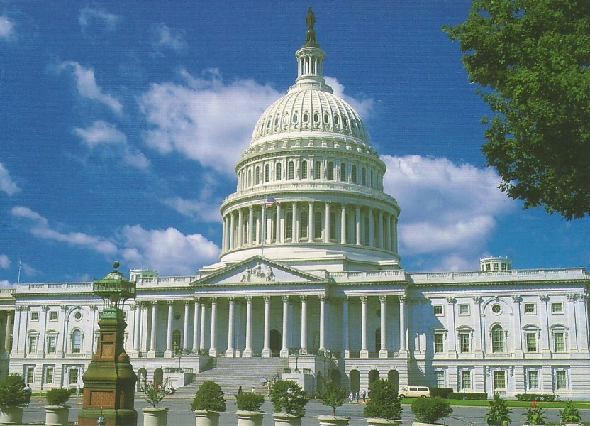
Regulation

Slide 13
As we found last year, more than nine in ten voters (93%) believe it is important to regulate financial services and products to make sure they are fair for consumers.
2013
2014
+87
+87
Darker colors indicate intensity.
How important is it to regulate financial services and products to make sure they are fair for consumers? Is it very important, somewhat important, a little important, or not at all important?

Slide 14
Support for increased government oversight of financial companies remains strong, with nearly two-thirds of voters agreeing that there should be more (65%) rather than less (24%) government oversight of these companies.
2013
2014
+40
+41
*split-sampled
Darker colors indicate intensity.
Generally speaking, do you think there should be more government oversight of financial companies, such as Wall Street banks, mortgage lenders, payday lenders, and credit card companies, or less oversight of these companies?

Slide 15
More than three-quarters of voters continue to agree that Wall Street financial companies should be held accountable with tougher rules and enforcement. Only one in ten believe their practices have changed enough that they don’t need further regulation.
2013
2014
Should Wall Street financial companies be held accountable with tougher rules and enforcement for the practices that caused the financial crisis, or have their practices changed enough that they don’t need further regulation?

Slide 16
By a 3:1 margin, voters believe that tough regulations on Wall Street will help prevent future financial problems rather than hurting the economy.
Please tell me which of the following statements comes closer to your own views. Tough regulations on Wall Street will help prevent future financial problems. Tough regulations on Wall Street will hurt the U.S. economy.

Slide 17
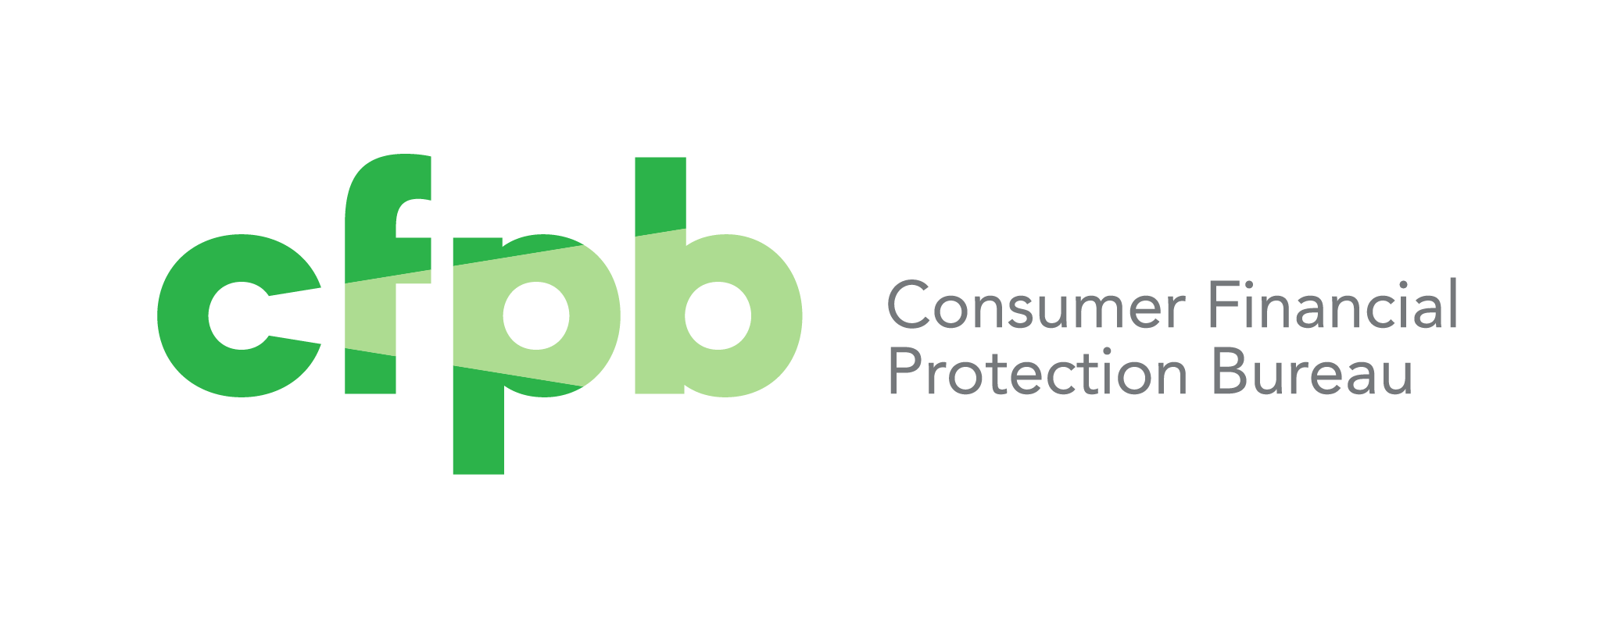
Consumer Financial Protection Bureau

Slide 18
Support for the Wall Street reform law remains resounding, with more than three-quarters of voters saying they favor the law’s federal oversight of financial companies.
2013
2014
+61
+58
*split-sampled
Darker colors indicate intensity.
As you may know, there is a new Wall Street reform law that requires federal oversight of financial companies that were not previously subject to federal regulation, including mortgage brokers, payday lenders, debt collectors, and companies that create credit reports and scores. Please tell me whether you favor or oppose requiring federal oversight of these financial companies.

Slide 19
Although voters broadly agree on the importance of regulation and oversight, on the matter of making sure financial services and products are fair for consumers, voters are only slightly more likely to trust the federal government (34%) than banks and credit card companies (31%).
2013
2014
+9
+4
*split-sampled
Darker colors indicate intensity.
Who do you trust more to make sure financial services and products are fair for consumers – banks and credit card companies, or the federal government? [IF CHOICE] Would you say you trust [RESPONSE] much more or somewhat more? [IF BOTH/NEITHER] Well, if you had to pick one, who would you trust more?

Slide 20
In contrast, a majority (55%) trust the CFPB over banks and credit card companies (17%). Voters respond more favorably to the name of the agency than to “the government.”
2013
2014
*split-sampled
Darker colors indicate intensity.
Who do you trust more to make sure financial services and products are fair for consumers – banks and credit card companies, or the Consumer Financial Protection Bureau? [IF CHOICE] Would you say you trust [RESPONSE] much more or somewhat more? [IF BOTH/NEITHER] Well, if you had to pick one, who would you trust more?

Slide 21
Over two-fifths of voters are unfamiliar with the CFPB. Democrats tend to be the most familiar, while Republicans are least likely to be familiar with the agency. Fewer Independents than last year now report familiarity with the CFPB.
Unfamiliar
Familiar
Most Familiar with CFPB
(% familiar)
-Democratic men: 73%
-Midwestern Democrats: 73%
-Northeastern Democrats: 72%
-Democrats 50+: 72%
-Strong Democrats: 71%
-HHI $50k-$75k: 71%
Least Familiar with CFPB
(% familiar)
-Under 30: 40%
-West South Central: 40%
-Mountain: 45%
-Republican women: 45%
-Republicans <50: 45%
Darker colors indicate intensity.
Now I'd like to ask you about some people, groups, and products. For each, please tell me whether you have a very favorable, somewhat favorable, somewhat unfavorable, or very unfavorable impression. If you haven't heard of {6}, or if you don't know enough about that person, group, or product to have an impression {5}, just say so and we will move on.
[READ NAME.] Do you have a very favorable, somewhat favorable, somewhat unfavorable, or very unfavorable impression of [NAME]?

Slide 22
Voters familiar with the CFPB favor it by more than a 4:1 margin. While Democrats’ support has increased, among Independents, familiarity with the CFPB has declined, which has lowered support levels.
Net | NO/NH
+39 | 37
+36 | 42
+45 | 39
+53 | 32
+55 | 30
+31 | 48
+17 | 42
+24 | 48
Unfavorable
Favorable
Darker colors indicate intensity.
Now I'd like to ask you about some people, groups, and products. For each, please tell me whether you have a very favorable, somewhat favorable, somewhat unfavorable, or very unfavorable impression. If you haven't heard of {6}, or if you don't know enough about that person, group, or product to have an impression {5}, just say so and we will move on.
[READ NAME.] Do you have a very favorable, somewhat favorable, somewhat unfavorable, or very unfavorable impression of [NAME]?

Slide 23
After hearing a brief description of the CFPB, three-quarters of voters favor the bureau (47% strongly). As in other areas, support has dipped slightly since last year but remains strong.
2013
2014
+67
+60
Darker colors indicate intensity.
Part of the Wall Street Reform law was the establishment of the Consumer Financial Protection Bureau, or CFPB. It is the first federal agency whose focus is protecting consumers when they use mortgages, credit cards, bank accounts, and other financial products and services. Its mission includes preventing deceptive, unfair and abusive lending and collection practices by banks and other companies. From what you know about the Consumer Financial Protection Bureau, or CFPB, would you say you favor or oppose the CFPB?

Slide 24
After hearing head-to-head arguments for and against the CFPB, a majority of voters agree with a statement that it works and protects consumers, while fewer than a third agree that it is an unaccountable and unnecessary bureaucracy.
Statement A: (Some/other people say) Wall Street special interests fund attacks against the Consumer Financial Protection Bureau because the CFPB works. It puts money back in consumers’ pockets and prevents confusing and unfair practices by credit card companies, payday lenders, and other financial companies that would otherwise be able to rip people off.
Statement B: (Some/other people say) The CFPB is another unaccountable, expensive, federal bureaucracy we don't need. The financial crisis was caused by government interference. Imposing even more regulation just hurts small businesses, costs jobs, and impedes economic recovery. The CFPB is yet another example of out of control, big federal government.
*split-sampled
Darker colors indicate intensity.
Part of the Wall Street Reform law was the establishment of the Consumer Financial Protection Bureau, or CFPB.
Now I’d like to read you a pair of statements about the Consumer Financial Protection Bureau. Of the two, please tell me which statement is closer to your own views.

Slide 25
Head-to-head statements with the argument in favor of the CFPB comparing financial products to other dangerous products results in a slightly wider margin of support for the CFPB. Again, support for the CFPB has decreased slightly since last year but remains strong.
Statement A: (Some/other people say) We have rules to guard against unsafe meat, appliances, and automobiles. The CFPB is there to provide similar rules for financial products. Just as it’s against the rules to sell dangerous toys, it should be against the rules to sell dangerous loans.
Statement B: (Some/other people say) The CFPB is another unaccountable, expensive, federal bureaucracy we don't need. The financial crisis was caused by government interference. Imposing even more regulation just hurts small businesses, costs jobs, and impedes economic recovery. The CFPB is yet another example of out of control, big federal government.
2013
2014
*split-sampled
Darker colors indicate intensity.
Part of the Wall Street Reform law was the establishment of the Consumer Financial Protection Bureau, or CFPB.
Now I’d like to read you a pair of statements about the Consumer Financial Protection Bureau. Of the two, please tell me which statement is closer to your own views.

Slide 26
By more than a 3:1 margin, voters agree with the CFPB’s use of its enforcement authority, after they hear an argument citing specific CFPB successes pitted against the accusation the CFPB uses its authority unfairly and costs jobs and taxpayer money. A majority side strongly with the statement that lawsuits like those against American Express and JP Morgan Chase are “exactly what the CFPB should be doing.”
Statement A: (Some/other people say) Companies that violate the law should be held accountable and made to pay. For example, in 2013 American Express and JP Morgan Chase had to pay fines and refunds totaling more than $400 million dollars as a result of their deceptive marketing and billing practices for credit card add-on products. Lawsuits like these are exactly what the CFPB should be doing.
Statement B: (Some/other people say) The CFPB is out of control, using taxpayer money to fund expensive lawsuits that hurt regular Americans and businesses. CFPB lawsuits unfairly target businesses that government regulators don't like, preventing these businesses from innovating and prospering. CFPB intrusion costs American jobs and money for consumers and taxpayers.
Darker colors indicate intensity.
The CFPB has used its enforcement authority to bring suits against companies it found to have violated the law. Please tell me which of the following two statements is closer to your own views about this type of regulatory action.

Slide 27

Policy Proposals

Slide 28
Three-fifths of voters agree that Wall Street and the financial industry pose a continuing danger to the economy due to their power and reckless practices. Fewer than a quarter think we have already done enough to reform the financial system.
Need for Reform: Combined
Reckless Practices*
Too Powerful*
+37
+38
+37
*split-sampled
Some people believe that Wall Street and the financial industry are [still engaged in reckless practices/are still too powerful] and pose a continuing danger to the economy. Others believe we have done enough to reform the financial system and further reform would hinder innovation and economic growth. Which of these positions comes closer to your views?

Slide 29
Voters remain strongly supportive of a policy requiring small-dollar lenders to verify customers’ ability to repay loans. Support is consistent whether this policy is framed simply in terms of verifying a customer’s ability to repay, or making sure loans are affordable in light of a customer’s income and expenses.
2013
2014
2013
2014
+81
+80
+82
+79
*split-sampled
Darker colors indicate intensity.
Now I am going to read you a series of proposals that are being considered to regulate financial products and services. For each, please tell me if you support or oppose the proposal.

Slide 30
Similar to last year, more than four-fifths of voters support requiring banks to decline debit card purchases rather than charge overdraft fees. They remain less enthusiastic about but still broadly supportive of a proposal to prevent banks from charging more than six overdraft fees per customer per year.
In order to protect consumers from excessive overdraft fees, banks cannot charge more than six overdraft fees per customer per year*
If you don’t have enough money in your account to cover a debit-card purchase, the bank must decline the purchase rather than charge you a $35 fee*
2013
2014
2013
2014
*split-sampled
Darker colors indicate intensity.
Now I am going to read you a series of proposals that are being considered to regulate financial products and services. For each, please tell me if you support or oppose the proposal.

Slide 31
Over three-quarters of voters support a proposal to allow bank customers to take complaints to court. This policy is slightly more popular than the proposal to allow borrowers to sue the same lender together over a common problem.
Bank customers would have the right to take complaints to court, instead of being required to accept dispute arbitration by a third party chosen by the bank or lending institution*
Borrowers must be allowed to sue the same lender together over a common problem*
+60
+55
*split-sampled
Darker colors indicate intensity.
Now I am going to read you a series of proposals that are being considered to regulate financial products and services. For each, please tell me if you support or oppose the proposal.

Slide 32
More than nine in ten voters support a requirement for credit card statements to state how much more customers will ultimately pay if they only make the minimum monthly payment. However, just over half of voters have noticed this change, up slightly from 2013.
“Credit card statements must now state how much more customers will ultimately pay if they
only make the minimum monthly payment.”
Awareness*
Support*
2013
2014
2013
2014
*split-sampled
Darker colors indicate intensity.
Now I am going to read you a series of new requirements that have been placed on financial companies in the last 4 years. For each, please tell me if you have noticed that change, if you have not noticed the change, or if you are not sure. Credit card statements must now state how much more customers will ultimately pay if they only make the minimum monthly payment.
Now I am going to read you a series of new requirements that have been placed on financial companies in the last 4 years. For each, please tell me if you support or oppose the change. Credit card statements must now state how much more customers will ultimately pay if they only make the minimum monthly payment.

Slide 33
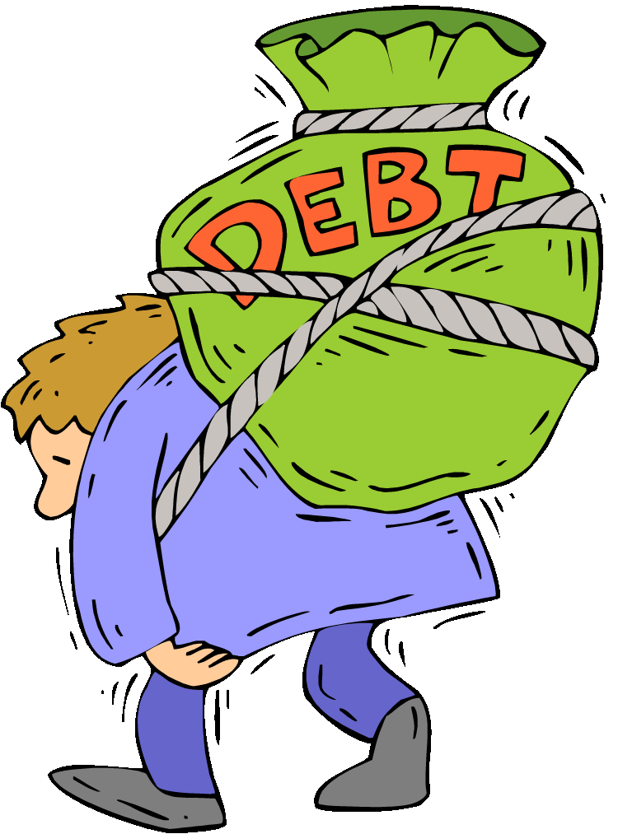
Loans and Debts

Slide 34
Voters have grown less sympathetic to borrowers. Last year, by a 14-point margin, they sided with a statement about lenders needing rules over one attributing debt problems to personal irresponsibility. Now, voters are divided between these two stances.
Statement A: Debt problems are a matter of personal irresponsibility. The answer is for people to watch their finances carefully, do a better job of understanding interest rates and repayment terms, and not take out loans they can’t afford.
Statement B: Lenders need rules. They should have to look at borrowers’ finances, and not offer loans to people who can’t afford to repay them. They should have to provide clear information about interest rates and repayment terms, so people can make wise choices.
2013
2014
+14
+1
Darker colors indicate intensity.
Now I am going to read two statements about loans. Please listen to both and tell me which statement is closer to your own views.

Slide 35
In keeping with their strongly negative views of payday lenders, by a 2:1 margin, voters agree with a statement describing payday lenders as predators targeting the elderly, working families, and single parents over a statement presenting them as a resource for those who can’t get credit any other way.
Statement A: Payday lenders prey on the elderly on Social Security, on working families making minimum wage, on military families, and on single parents. In this economy, it’s hard enough for families living paycheck to paycheck to make ends meet, without having to resort to 300 and 400 percent interest rate loans – that’s just too much.
Statement B: Payday lenders are an important resource for those who can’t get credit any other way. If people can't afford to pay the interest, they shouldn't borrow the money. As long as the terms of the loan are clearly posted, people can make their own decisions and not have the government controlling what they do with their own money.
Darker colors indicate intensity.
Now I am going to read two statements about payday lenders. Please listen to both and tell me which statement is closer to your own views.

Slide 36
Seventy percent of voters agree that the federal government should be doing more to help those who are struggling with student loan debt. African-American voters, Democrats, women, and voters in the South are especially likely to agree.
Most Likely to Agree:
African American <50 – 92%
South African American – 89%
African American Democrat – 89%
South Democrat – 87%
African American Women – 87%
African American – 87%
Democratic Women – 86%
Strong Democrat – 86%
Darker colors indicate intensity.
I am going to read you a series of statements about student loans. For each, please tell me if you agree or disagree with the statement. The federal government should be doing more to help those who are struggling with student loan debt.

Slide 37

Wall Street Influence

Slide 38
Four in five voters are concerned about the influence Wall Street financial companies have on elected officials.
Darker colors indicate intensity.
How concerned are you about the influence of Wall Street financial companies on elected officials—very concerned, somewhat concerned, a little concerned, or not at all concerned?

Slide 39
A majority of voters say they would be less likely to vote for a candidate who received large sums of money from big banks and financial companies. By a 2:1 margin, voters also say they would be more likely to vote for a candidate who favored stronger regulation of Wall Street.
Received Large Sums of Money*
Favored Stronger Regulation*
+42
+24
*split-sampled
Darker colors indicate intensity.
And if you knew that a candidate or member of Congress had received large sums of campaign money from big banks and financial companies, would that make you more or less likely to vote for him or her, or would it not make a difference to you?
And If you knew that a candidate or member of Congress favored stronger regulation of Wall Street and the financial world, would that make you more or less likely to vote for him or her, or would it not make a difference to you?

Slide 40
Pluralities of voters across party lines would be less likely to support a candidate who received large sums of money from financial companies and more likely to support a candidate who favored stronger regulation of Wall Street.
Received Large Sums of Money*
More Likely
Less Likely
Net | DK
+47 | 2
+42 | 2
+37 | 1
+44 | 1
+23 | 7
+5 | 7
Favored Stronger Regulation*
Less Likely
More Likely
*split-sampled
Darker colors indicate intensity.
And if you knew that a candidate or member of Congress had received large sums of campaign money from big banks and financial companies, would that make you more or less likely to vote for him or her, or would it not make a difference to you?
And If you knew that a candidate or member of Congress favored stronger regulation of Wall Street and the financial world, would that make you more or less likely to vote for him or her, or would it not make a difference to you?

Slide 41


Washington, DC | Berkeley, CA | New York, NY
LakeResearch.com
202.776.9066
Celinda Lake
clake@lakeresearch.com
David Mermin
dmermin@lakeresearch.com
Liesl Newton
lnewton@lakersearch.com

