Slide 1

Shadow Banking—
Measures for Monitoring and Mitigating?
Dr. Laura E. Kodres
International Monetary Fund
November 22, 2013

Slide 2
Main takeaways
Measuring shadow banking is hard, but we are making progress …
  Mainly on issues of size and locations/types of institutions and markets
We need to step up the efforts on …
  Measures of risks, especially leverage and interconnectedness
  Catching buildups of vulnerabilities earlier by being more flexible and using market intelligence
  Connecting our measures to actual tools of mitigation

Slide 3
What do we want to measure and monitor?
GOAL: “Shadow banking” risks that could become “systemic” and harm the economy
The location of the risks/where they reside
  Institutions
  Markets
The size of the risks
The nature of the risks/how they transmit
The likelihood that the risks materialize

Slide 4
Basic systemic risks of concern
Excessive leverage
  Procyclicality of margin/collateral valuation
Overly-large maturity mismatches between assets and liabilities
  Especially illiquid assets financed by short-term, wholesale liabilities
Potential (liquidity) runs and associated knock-on effects (including solvency)
  Long chains of intermediaries, often leading to runs (or “flight to quality”—types of contagion)
  Interactions between funding and market liquidity (funding difficulties + fire-sales)

Slide 5
Status of measurement and monitoring
Location of risks
  Known institutions: B-Ds, MMF, SIVs/Conduits, insurance (some activities)
  Questionable institutions: hedge funds, asset managers, finance companies, other
  Known markets: repo markets, securities lending, ABCP
  Questionable markets: “private” lending, leveraged loans

Slide 6
Status of measurement and monitoring
Size of risks (E.g., FSB Monitoring Report)
  National Flow of Funds data
  BIS bank data
  IMF Coordinated Portfolio survey
  Other data sources/piecemeal approach
  Market intelligence

Slide 7
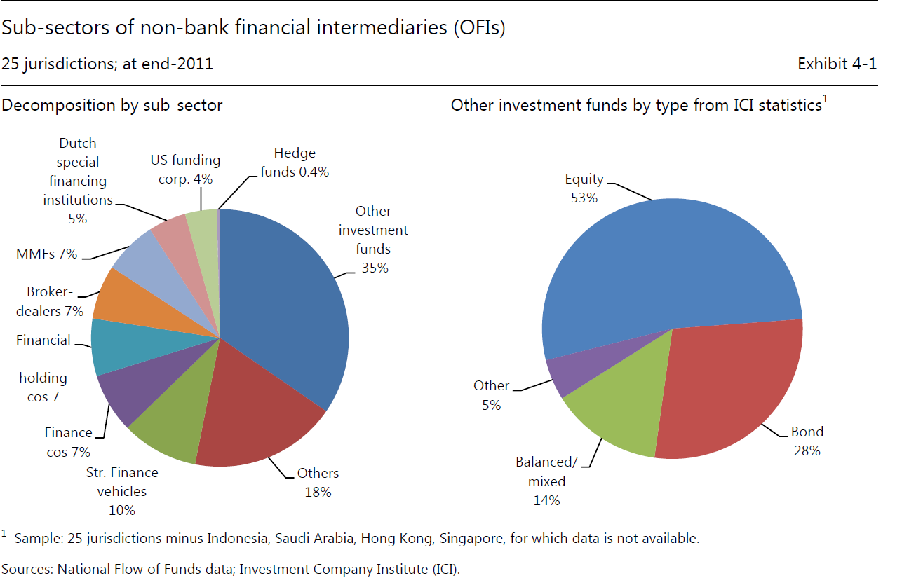
2012 FSB Monitoring Exercise: OFIs

Slide 8
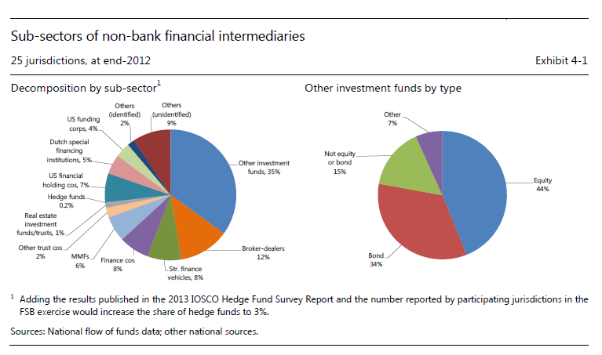
2013 FSB Monitoring Exercise: OFIs

Slide 9
Status of measurement and monitoring
Nature of risks, transmission mechanisms
  Combining BIS bank data/supervisory data
  Trade repositories
  Global flow of funds (in progress)
The likelihood that the risks materialize
  Rule-of-thumb threshold analysis
  Vulnerability measures (a few systemic liquidity measures)
  Some options-type models (CCA)

Slide 10
The future of measurement and monitoring
Location
  Institutions COMBINED with markets
  Who is trading in which (possibly connected) markets
  Ex: asset managers use of security lending
  Ex: insurance company use of leveraged loans
Size
  Size COMBINED with growth
  Size compared with what (financial sector? GDP?)

Slide 11
The future of measurement and monitoring
Need to be able to collect the information
Need to flexible and adaptive about what to collect
Examples:
  Private-label securitization no longer large and more highly regulated
  U.S. REITS with agency MBS growing fast and contain maturity mismatches
  Rapid growth of retail MMF in China

Slide 12
U.S. Private-Label MBS Issuance
Source: Inside Mortgage Finance and IMF staff estimates

Slide 13
Example 1: U.S. REITs Funding

Slide 14
Example 1: U.S. REITs Relative Size

Slide 15
Example 2: Yu’E Bao in China
China’s first on-line investment fund for individuals (automated transfers between bank checking/Alibaba account/Yu’E Bao)
Connected to Alipay, China’s 3rd largest third-party payment platform with 800 m. customers
Now largest MMF—RMB 55.7 billion ($9.2 billion)
13 million customers at end-Sept (launched in June)
Interest rate is ～5% (vs 0.35% in bank deposits)
Redemptions can be made at any time
Apparently, investments are in government and corporate money markets

Slide 16
Future of Measurement and Monitoring
Need better data and measures of:
  Degree of leverage for non-banks
  Degree of maturity mismatch
  Degree of interconnectedness including cross-border transmission
Need to develop models of the probability that risks materialize
  More on “run risk” vulnerability
  Triggers?

Slide 17
What is the IMF doing to help?
Working on a global flow of funds (GFF) framework
Working with FSB on developing the data architecture for collecting data on repos and securities lending
Upgrading its CPIS (Coordinated Portfolio Investment Survey)
  Will include more information about the sectors of non-resident issuers and holders of securities.
  Increase frequency to semi-annual and decrease lag time to release
Revising the FSI (Financial Soundness Indicators)
  Will include measures of leverage consistent with Basel III
  Will include maturity distribution and sectoral distribution of assets for MMFs

Slide 18
Next step: connect to mitigation tools
Examples
  Degree of interconnectedness/systemic importance proportional to capital surcharge (See Chapter 2 GFSR April 2011 for liquidity, Chapter 2 GFSR April 2010 for solvency)
  A “tax” on the excessive use of non-core liabilities (e.g., Korea)
Need to incentivize the reduction of the risks by matching the “cost” to the contribution to systemic “risk.”

Slide 19
Shadow Banking—
Measures for Monitoring and Mitigating?
Dr. Laura E. Kodres
International Monetary Fund
November 22, 2013

