Slide 1
The Challenge of Shadow Banking
Marcus Stanley
Policy Director
Americans for Financial Reform

Slide 2
How Did We Go From This…
Savers – households, non-financial business
Intermediary Banks
Borrowers – household purchases, business investment

Slide 3
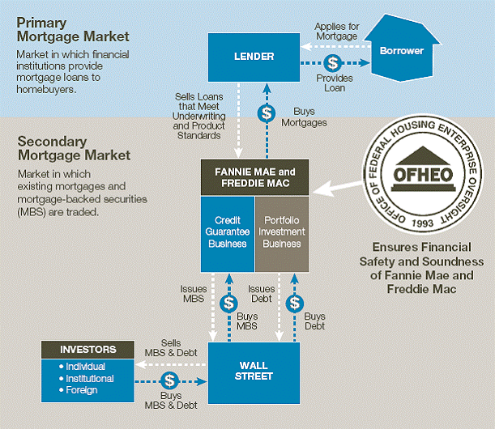
And This…

Slide 4
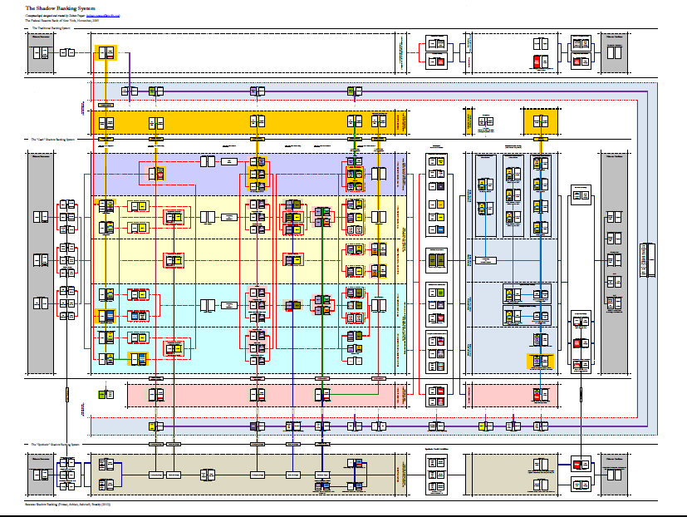
To This?

Slide 5
And what should we do about it?

Slide 6
The Growth of Shadow Banking
In 1970: 80 percent of financial sector liabilities were ‘traditional’ regulated liabilities like bank deposits, checking accounts, and insurance company reserves.
By 2007: only 40 percent of financial sector liabilities were ‘traditional’.

Slide 7
Differences From Commercial Banking
Just like commercial banking, shadow banking converts illiquid, risky, long-term assets into ‘safe’, liquid assets convertible to cash on short notice.
But does it through market mediated credit.
  From risks that are held to risks that are sold.
Much longer, more complex credit chains.
  Many unregulated non-banks, but banks play key role.

Slide 8
Key ‘Shadow Banking’ Markets
Securitization markets >> real economy credit.
  Replacing own-book commercial bank lending.
Securities lending markets >> within financial sector flows.
  Replacing unsecured interbank, Fed lending.
Derivatives markets >> risk transfer.
Commercial paper.

Slide 9
Shadow Banking: Why Worry?
Market mediated credit is just as old and just as traditional as commercial banking.
Spreads risk and allows fine-tuning of assets to investor preferences, increasing credit availability.
Government-supported secondary mortgage markets date from Depression.
  Bear certain similarities to ‘shadow banking’ and worked well for many years.

Slide 10
Shadow Banking: Why To Worry
Extended credit intermediation chains multiply opportunities for fraud, deception.
  Complexity undermines market discipline.
Complexity conceals and heightens leverage.
Pro-cyclical linkage to market prices.
Result: financial fragility, boom-bust cycles.

Slide 11
Shadow Banking And the Safety Net
Risk conversion relies on private guarantees.
  Guarantees from ‘too big to fail’ institutions.
  Supposedly ‘safe’ collateral. Subordination.
Private safety net is systemically unreliable.
Systemic event creates major pressure on government to back private guarantees.
Private sector expansion of implicit safety net undermines market discipline.

Slide 12
The Challenge To Regulation
Measurement and oversight of risk.
Ease of arbitrage when risks move between regulated and unregulated sector.
Difficulty defining bounds of the safety net.

Slide 13
The Dodd Frank Act Does Not Fully Address These Issues
Important areas of shadow banking completely omitted from DFA.
  Regulatory efforts on securities lending, money market funds, slow and inadequate so far.
  Division between market and prudential regulators a problem.
Dodd Frank Act ambivalent on the safety net.
Capital rules still permit extensive risk transfer.
Office of Financial Research – a mixed record.

Slide 14
Some Key Questions
How far will regulation of the large dealer banks take us?
  TBTF banks were at the center of the shadow banking system, but other central dealers and guarantors could emerge.
Designation of non-banks – asset managers?
How to ensure private market discipline?

Slide 15
Some Broader Thoughts
Need to end the complexity bias in our regulatory system. Lean against forms of ‘financial innovation’ that promise risk transfer benefits but increase fragility.
Examine increased support for commercial banking model of on-book lending.

