Slide 1
Can Cost Benefit Analysis Pass The Cost Benefit Test?
Marcus Stanley, Phd
Policy Director
Americans for Financial Reform

Slide 2
Considering Costs vs. CBA
Consideration of costs and benefits is an essential part of any decision making process.
Formal ‘Cost Benefit Analysis’ (CBA) is something else.
Standards vary, but generally includes mix of--
  Formal finding that benefits exceed costs (or reverse).
  Quantifiable if at all possible.
  Subject to judicial review.
  ‘Veto point’ structure.

Slide 3
CBA In Financial Regulation
Real-world political economy of formal CBA is likely to be a disaster in financial arena.
Two key problems:
  Financial regulation: large and concentrated private costs, massive but diffuse public benefits.
  Enormous methodological issues with trying to actually measure costs and benefits.
Actors are very aware of their private costs, public does not have the resources to oppose.
An ‘expert’ process like CBA will be co-opted because of the limits of our knowledge.

Slide 4
Public Benefits, Private Costs
Only true net benefits to society should be considered in cost benefit analysis.
Transfers from one private actor to another should be disregarded, except in cases where equity/fairness concerns are involved.
The more externalities and transfers are involved in policy, the more challenging this becomes analytically – and politically.
Notes:
My private benefits are not benefits to society as a whole because they are associated with costs to you – thus eliminating my private benefits may even benefit society.

Slide 5
Public Benefits, Private Costs
Excessive leverage
  amplifies short run private profits but creates destructive externalities. Capital, derivatives, structured products.
Market concentration in finance
  change creates huge private costs, any public cost?
Complexity and opacity
  concealing risks from buy side and regulators
  dark market externalities (Bolton, Santos, Scheinkman, 2012)
Public subsidies create incentive problems
  Not just TBTF guarantee, but bankruptcy and tax
Endemic agency problems
  Fiduciary responsibilities, short-term pay incentives

Slide 6
Measurement Uncertainty -- Leverage
Modigliani-Miller insight: leverage restrictions have at most very limited social costs.
  Many prominent economists argue for extremely low costs of leverage limits.
  Industry disagrees: claims Basel capital requirements will cost $2 trillion in GDP, 7.5 million jobs by 2015.
We are deep into a highly uncertain area, the macroeconomics of money and finance.
  Stein (2011): “Monetary Policy As Financial-Stability Regulation”
Macroeconomic impacts of financial crises can be catastrophic. Do we even know why?

Slide 7
Finance and the Macroeconomy –
The Missing Link
“Needless to say, if you want to build a model where finance matters, so that there is a link between developments in the financial sector and those in the real sector, you will have to model the reason for finance existing in the first place.”
“We clearly need macroeconomic models in which financial intermediaries play a significant role...by either ignoring banks or assuming that they are just like any other industrial firm, our models are clearly missing something essential….Putting financial intermediation into macroeconomic models is the first step.”
“The prevailing macroeconomic paradigm requires a very strong form of rationality: agents make decisions in a fully optimising way, with complete knowledge of the underlying economic model….Casual (and not so casual) observation of past boom-bust episodes suggests an absence of rationality”
Cecchetti et. al. 2009 (BIS)

Slide 8
Measurement Uncertainty – Market Concentration
Large ‘universal banking’ model:
  attempt to increase monopoly power?
  access to implicit government subsidies?
  conceal risk?
  take advantage of genuine economies of scale?
  all of the above?
Can economics clearly sort out these factors?
No: after decades of work, no consensus on whether economies of scale exist for large banks
  This is the literature that informed GLB.

Slide 9
Measurement Uncertainty -- Complexity
Increased complexity of market structure and instruments.
Easier to hide risk, arbitrage regulations.
  Acharaya et al. – ABCP conduits as fake risk transfer to arbitrage capital regulation.
  Boaz, Barak, Brunnermeier – computational complexity and structured products, derivatives.

Slide 10
From this…
Savers – households, non-financial business
Intermediary Banks
Borrowers – household purchases, business investment

Slide 11
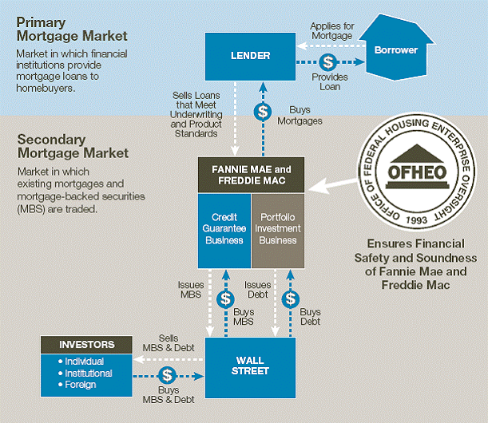
Or even this…

Slide 12
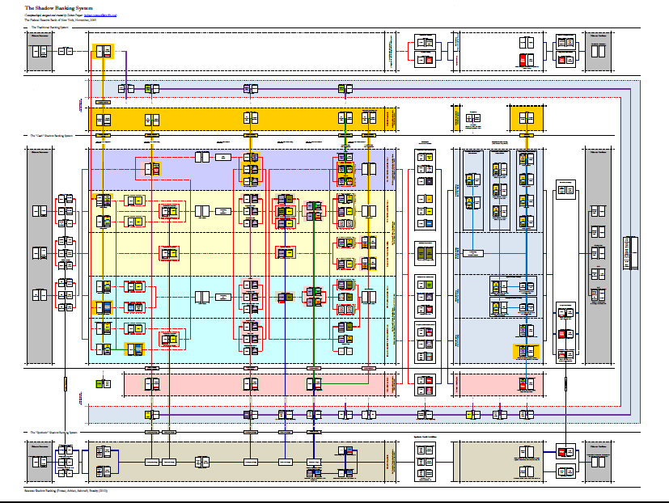
To this…

Slide 13
Measurement Uncertainty – Real Economy Connection
Finance an intermediary sector.
Has grown massively over past decades
  5% of economy in 1980 to over 8% today.
But little evidence of real economy benefits.
Phillipon (2012) – financial efficiency has not increased over the 20th century
  Looks like law, medicine, education, not a sector where growth is productivity driven.

Slide 15
Uncertainty, high stakes, insider power….
Industry still has the best data access
  Provides analysis supportive of preferred conclusion, resists regulatory requests for raw data
Flood the process with shoddy ‘studies’.
  E.g. NERA on swap dealer costs of margin – measures total margin at company marginal cost of capital
Huge inputs into key veto points. Mobilize Congress
Success in holding back regulation even where benefits are clear
  AFR August 2011 letter: Basel Committee cooked their own cost benefit analysis in setting capital charges.

