Slide 1
Higher Capital Requirements:
A Case of Huge Benefits with
Negligible Costs
Paul Pfleiderer
Stanford University
Capital Controversies: The Benefits and Costs of Bank Capital Requirements
July 15, 2011

Slide 2
Higher Capital Requirements
Benefits are LARGE! This is not controversial.
Costs? This is very controversial because of:
  Pervasive confusions based on not distinguishing private from social costs;
  Pervasive fallacies based on not understanding what equity capital is;
  Pervasive fallacies based on not understanding the relationship between risk and funding costs; and
  Silly and misleading fixation on ROE (return on equity).

Slide 3
Benefits of Requiring Much More Equity
(e.g. 15% to 25%)
Systemic Risk is greatly reduced.
  Less chance of financial crisis and deadweight losses.
Risk is privatized; not borne by the government and citizens.
  Pricing is not distorted.
Incentives to take socially unproductive risks are reduced.
Debt overhang: With too much debt good opportunities may not get funded by shareholders because new funding would benefit existing creditors at the expense of shareholders.

Slide 4
Benefits
“Had the share of financial assets funded by equity been significantly higher in September 2008, it seems unlikely that the deflation of asset prices would have fostered a default contagion much, if any, beyond that of the dotcom boom.”
Alan Greenspan, “The Crisis,” Brookings Papers, April 15, 2010.
“.. if capital and collateral are adequate...losses will be restricted to equity shareholders who seek abnormal returns; Taxpayers will not be at risk. Financial institutions will no longer be capable of privatizing profit and socializing losses.”
Alan Greenspan, (quoted in “Greenspan Defends Legacy, Urges Higher Capital, Collateral Standards,” WSJ, April 7, 2010).

Slide 5
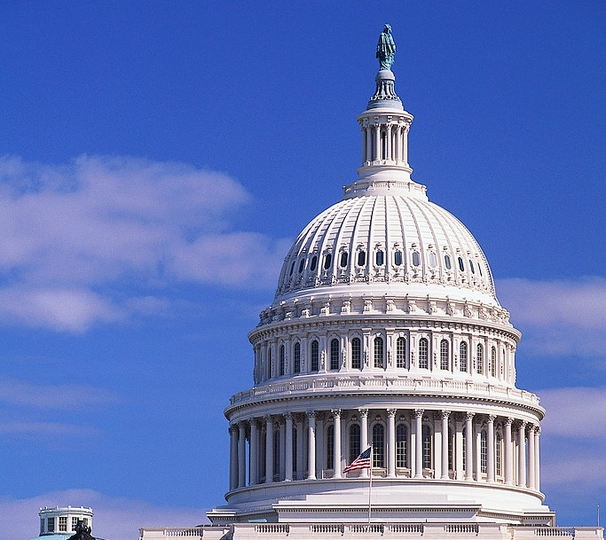
Equity
Equity
Bailout
Equity
Equity
Debt
Assets
Before
Assets
Before
Debt
Assets
After
Assets
After
Too Much
Leverage
More Equity

Slide 6
Private Versus Social Costs of Equity
Private Costs
Social Costs
Equity does not produce tax shield; debt does.
The government makes debt cheap through implicit guarantees.
Increasing equity mechanically reduces ROE (but reduces risk as well). If compensation is for some reason rigidly tied to ROE, this will reduce some people’s pay.
?

Slide 7
The Too-Big-To-Fail Subsidy
If creditors of a bank believe that there is a chance they will be bailed-out by the government in situations of systemic distress, they will accept lower yields.
Extra Return
Reduced Cost in
on Equity
Basis Points
(with 3% equity)
2.50
0.81%
5.00
1.62%
7.50
2.43%
10.00
3.23%

Slide 8
Moody’s Announcement: June 2, 2011
SUPPORT FOR BOFA, CITI, AND WELLS FARGO EXCEEDS PRE-CRISIS LEVELS
Moody's government support assumptions for Bank of America, Citigroup, and Wells Fargo are higher than what similarly rated institutions would have received prior to the crisis. For example, Bank of America N.A.'s and Citibank N.A.'s C- (C minus) unsupported BFSRs translate to a Baa2 rating on Moody's long-term debt scale; prior to the crisis a similarly rated, systemically important bank would typically have benefited from no more than three notches of uplift, meaning its ratings would be no higher than A2. Currently, Bank of America receives five and Citibank four notches of uplift from government support assumptions, bringing their senior ratings to Aa3 and A1, respectively. Wells Fargo's unsupported BFSR of C+ (C plus) translates to an A2 rating on Moody's long-term debt scale; prior to the crisis a similarly rated, systemically important bank would typically have received no more than two notches of uplift, to Aa3. Currently, Wells Fargo's Aa2 senior rating benefits from three notches of uplift.

Slide 9
Subsidizing Banks
It might be asserted that, although the tax code and implicit guarantees create subsidies, this is good because:
  Banks pass these on to borrowers in the form of lower borrowing costs.
  Lower borrowing costs stimulate growth.

Slide 10



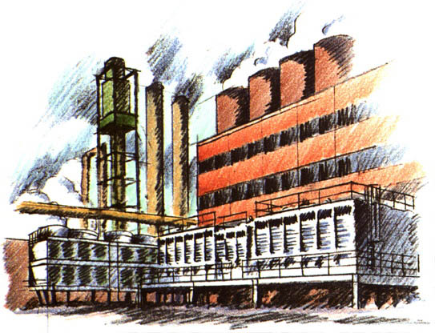


Rolling
River
Tax Refund For
Every Barrel Dumped
= $2.50 a Barrel
Cost = $20.00
Cost = $20.00
minus
$8.00 government subsidy
= $12.00
Higher Stock Price
Happy Manager
Baby Bottles are Good
for the Economy
and We Should Make Sure
They Are Available at Low Cost
$1.89
$1.72

Slide 11

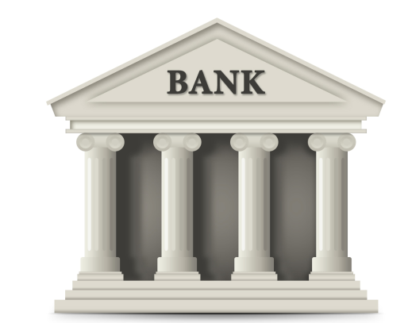
Financial
Markets
And
Greater Economy
Systemic Risk
Debt
(high levels of leverage
create systemic risk
and distort risk
taking incentives)
Equity
(provides
cushion that absorbs
risk and
limits incentives
for taking
socially inefficient risk)
Funding
( )
Loans

Slide 12

Financial
Markets
And
Greater Economy
Government Subsidies to Debt:
1. Tax shield (interest paid is a deductible expense but not dividends)
2. Safety net and implicit guarantees mean banks pay lower rates
Debt
Systemic Risk
Debt
Equity
Equity
Funding
Higher Stock Price
Happy Banker
( )
Loans
Lower Loan Costs
?

Slide 13
Balance Sheet Fallacy
“Capital is the stable money banks sit on... Think of it as an expanded rainy day fund.” (AP July 21, 2010).
“Every dollar of capital is one less dollar working in the economy” (Steve Bartlett, Financial Services Roundtable, Sep. 17, 2010.)
“The British Bankers' Association … calculated that demands that they bolster their capital will require the UK's banking industry to hold an extra £600bn of capital that might otherwise have been deployed as loans to businesses or households.” (The Observer, July 11, 2010).

Slide 14
Confusing Language
“Hold” or “set aside” misleadingly suggests idle funds, passivity, cost.
Liquidity/reserve requirements concern asset side of balance sheet, restrict holdings.
Capital requirements concern funding side only.
  A firm does not “hold” the securities it issues, investors do!
Ultimately we are just talking about the labels and the contractual terms associated with the claims banks issue to raise funds.

Slide 15
Three Ways to Increase Capital
Increased Capital Requirements need NOT force banks to reduce lending:
Initial Balance Sheet
Revised Balance Sheet with Increased Capital Requirements
(10% Capital)
(20% Capital)
New Assets: 12.5
Equity: 22.5
Equity: 10
Equity: 20
Loans: 100
Deposits & Other
Loans: 100
Deposits & Other
Loans: 100
Deposits & Other
Liabilities: 90
Equity: 10
Liabilities: 80
Liabilities: 90
Loans: 50
Deposits & Other
Liabilities: 40
A: Asset Liquidation
B: Recapitalization
C: Asset Expansion

Slide 16

Risk Fallacies
If a bank’s assts decline in value by $60B, there is a $60B loss that must be borne by someone.
You can “hide” the loss with clever accounting, but you can’t make it disappear.
The only question is who bears the loss:
  The bank’s creditors
  The bank’s shareholders
  The government and its taxpayers

Slide 17
Risk
First principle: The market should be used to allocate and price risk.
  Risk should not be borne by government and taxpayers since, among other things, this circumvents the market and causes distortions.
Second principle: If the government is out of the picture (subsidies related to taxes and guarantees are removed) and the market is working, changing capital (leverage) does not change the total pricing of risk.
  Changes in capital requirements and leverage just change how risk is allocated across shareholders and creditors.

Slide 18
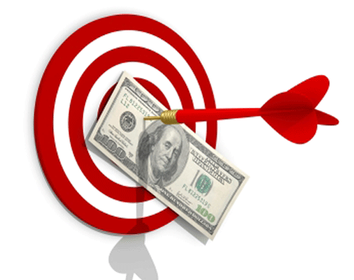
“Target” ROE
Shareholders do not have a “target” ROE that is independent of the risk they must bear.
As the risk they are exposed to decreases, so does the required expected rate of return.
Higher capital decreases risk and decreases the required expected rate of return.
If this is not true, then the market is not working and we have bigger problems.

Slide 19
ROE and Capital
Higher capital
  Reduces ROE in good times
  Raises ROE in bad times
  ⇒ Value is preserved
  ⇒ Risk is reduced
Lower risk reduces equity holders’ required return
25%
ROE
(
Earnings
Yield)
Initial
20%
10% Capital
15%
10%
Recapitalization
to 20% Capital
5%
0%
3%
4%
5%
6%
7%
-5%
-10%
-15%
Return on Assets
(before interest expenses)

Slide 20
Fixation on ROE is Silly and Misleading
Does a higher ROE mean that the manager has performed well?
"Normal" ROA
Total
Interest
(before
Realized
Rate
interest exp. )
Extra ROA*
Waste**
ROA
on Debt
% Equity
ROE
Good Bank Manager
3.00%
0.25%
0.00%
3.25%
2.0%
10.0%
14.500%
Bad Bank Manager
3.00%
0.00%
0.25%
2.75%
2.2%
3.0%
20.533%
Bad Bank Manager ***
3.00%
0.00%
0.25%
2.75%
2.0%
3.0%
27.000%
*Because of Skillful Management
**Because of Bad Management
*** With government debt subsidy

Slide 21
Where Will All This Equity Come From?
Answer: Much of it is already there.
  Non-deposit debt (e.g. long term debt) can be swapped for equity.
  In this case additional funds are not being raised; only the mix of financing is being changed.
Payout restrictions can augment equity capital rather quickly.

Slide 22
What about “Issuance Costs?”
Less leverage ⇒
  Greater ability to rely on retained earnings, less need for issuance
  Less price impact of any under-pricing
“Stigma” can be mitigated by regulators.
  Equity payouts (dividend) restrictions
  Rights offerings
  “Dilution” due to removal of subsidy not a social cost.
Notes:
Payout policy (paying divs while receiving TARP money), analogy to margin requirements.

Slide 23
“Balance Sheet Expansion” and End Investors
A
Mutual
Funds
Mutual
Funds
A
B
Investors
B
Investors
Equity
Equity
C
C
Banking
Sector
Assets
Banking
Sector
Assets
Deposits
And
Other
“Liquid”
Debt
Deposits
And
Other
“Liquid”
Debt
All the Assets
In the Economy
Banking Sector
All the Assets
In the Economy
Banking Sector
Productive opportunities and portfolios need not change.
Eventual size of balance sheets to be determined “naturally.”

Slide 24
Private “Benefits” of Equity and (non-demand-deposit) Debt
3
1
2
DEBT
EQUITY
Tax advantages make it cheap
Implicit guarantees make it cheap
ROE fixation

Slide 25
SOCIAL Benefits of Equity and (non-demand-deposit) Debt
2
1
3
DEBT
EQUITY
Reduces systemic risk
Reduces incentives for
  excessive risk-taking
Reduces deadweight costs
  associated with bailouts
Tax advantages make it cheap
Implicit guarantees make it cheap
ROE fixation

Slide 26
Equity as a Percent of Assets for US Commercial Bank
(From: Berger, Herring and Szegö, “The Role of Capital in Financial Institutions,” Journal of Banking and Finance, 1995)
60%
50%
40%
30%
20%
10%
0%
1840
1850
1860
1870
1880
1890
1900
1910
1920
1930
1940
1950
1960
1970
1980
1990

