Slide 1
Financial Innovation, Leverage, Bubbles, and the Distribution of Income
Margaret M. Blair
Vanderbilt University Law School
for
Restoring the Balance: Financial Regulation and the Real Economy
Conference of Americans for Financial Reform
June 28, 2011

Slide 2
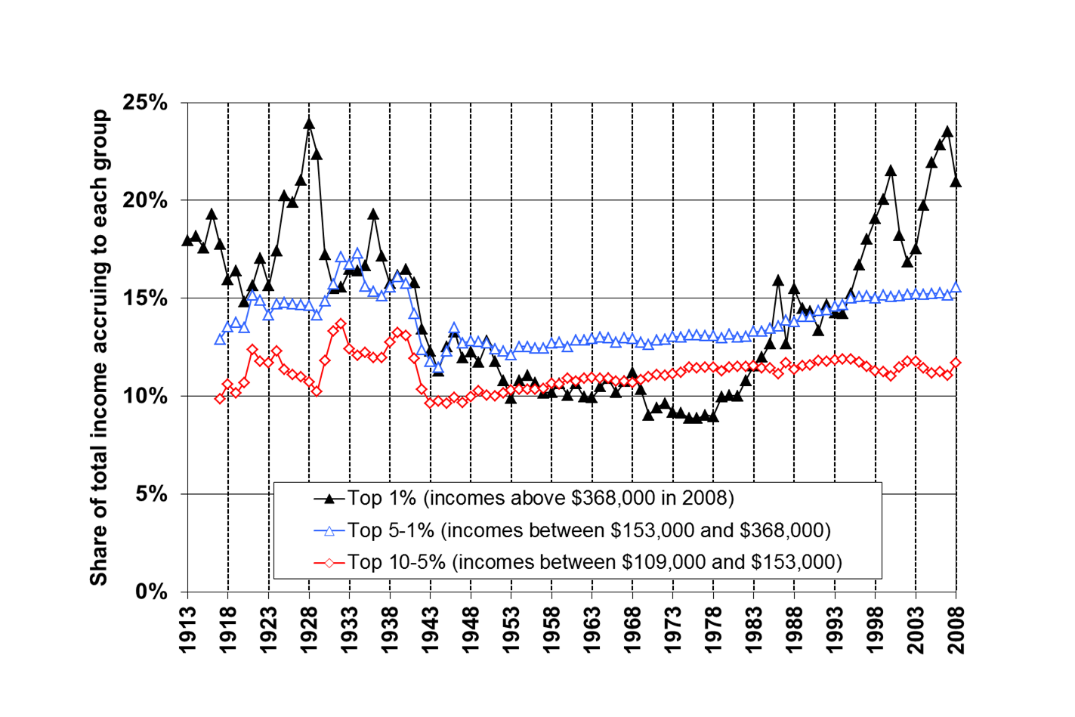
Share of Income Going to Top Decile

Slide 3
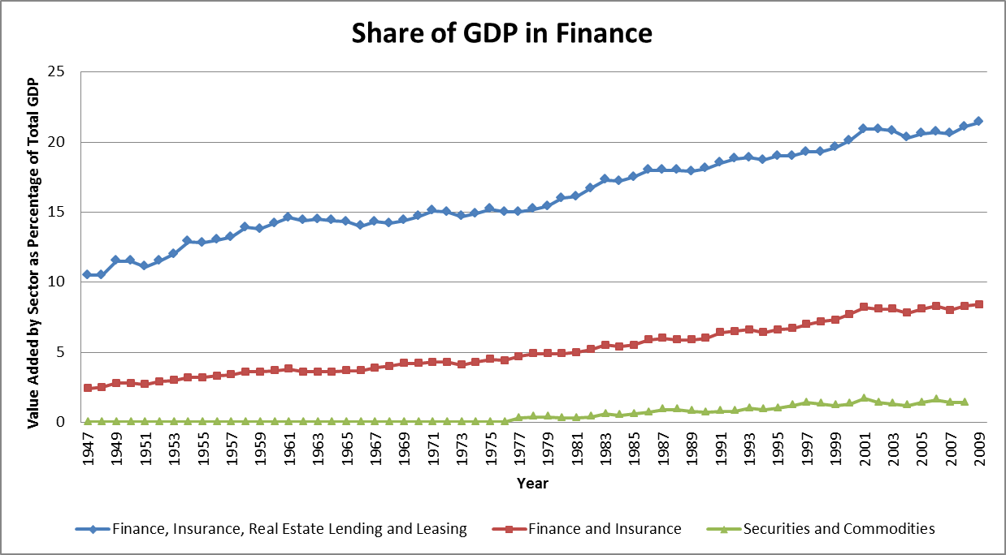

Slide 5
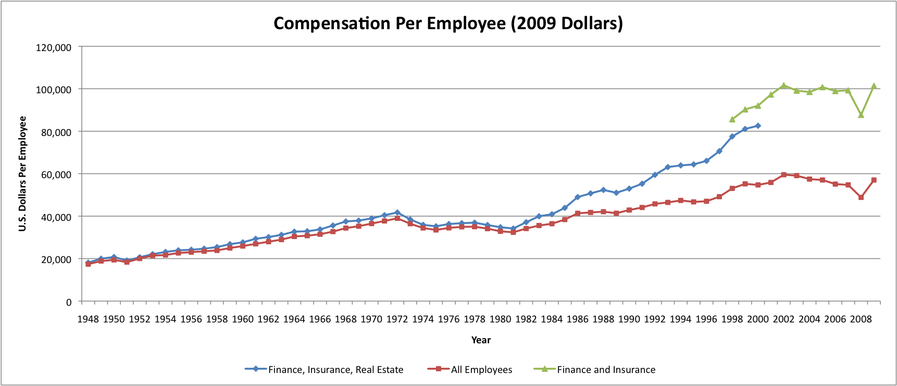

Slide 8
90% Leverage
$ 1 MILLION
$ 9 MILLION
DEBT

Slide 9
95% Leverage
$500,000
$ 9.5 MILLION
DEBT

Slide 10
95% Leverage
$ 1 MILLION
$ 19 MILLION
DEBT

Slide 11
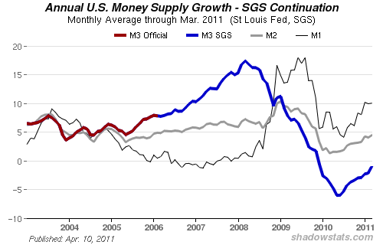
Click here to view more charts, including Mo

