Slide 1
The Dark Side of
Shadow Credit Intermediation
Adam B Ashcraft
Senior Vice-President and Head of Credit Risk Management
23 November 2013

Slide 2
Outline
Why does shadow credit intermediation exist?
Why should we be concerned?
What have we learned?
What should we worry about now?

Slide 3
Why does shadow credit intermediation exist?
Source: Ashcraft, Adrian, and Cetorelli (2013)

Slide 4

Why should we be concerned?
Regulatory arbitrage
Neglected risks
Funding fragilities
Leverage cycles
Agency problems

Slide 5
What went wrong?
Asset-backed commercial paper

Slide 6
What went wrong?
Money market mutual funds

Slide 7
What went wrong?
Tri-party repo

Slide 8
Securitization

Slide 9
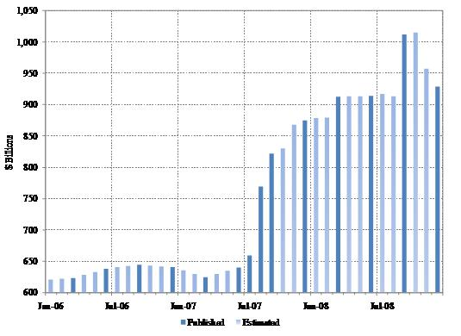
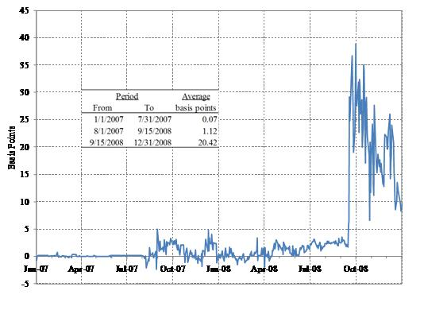
What went wrong?
Government Sponsored Agencies
FHLB Advances outstanding
Non-FHLB vs FHLB Libor panel bid
Source: Ashcraft, Bech, and Frame (2008)

Slide 10
What went wrong?
Credit Derivatives

Slide 11
What to worry about now?
Agency Mortgage REITs

Slide 12
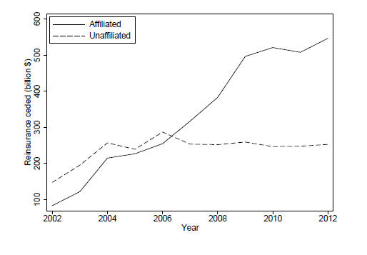
What to worry about now?
Reinsurance
This figure reports life and annuity reinsurance ceded by U.S. life insurers to affiliated and unaffiliated reinsurers. Reinsurance ceded is the sum of reserve credit taken and modified coinsurance reserve ceded.
http://papers.ssrn.com/sol3/papers.cfm?abstract_id=2320921

Slide 13
What to worry about now?
Leveraged Lending

Slide 14
What to worry about now?
Chinese Shadow Banking

