Slide 1
Approaching Regulation
L. Randall Wray, Levy Economics Institute and University of Missouri—Kansas City
www.levy.org; wrayr@umkc.edu

Slide 2
Approaching Regulation
To Reform the System We must Understand:
  What is the nature of the financial system today?
  What is the nature of the crisis?
  What is the nature of the crisis response?
  What should a financial system do?
  How can we reform the system so that
    It serves a public purpose
    It can be managed
    It can be rescued

Slide 3
A Minsky Moment or a Minsky Half-Century?
Stages Approach
  Commercial capitalism
  Finance capitalism
  Paternalistic (Managerial-Welfare State) capitalism
  Money Manager capitalism (predator state, financialization, ownership society, neoliberalism, neoconservativism, shadow banking)
    Stability bred instability
    Accumulation of financial assets/liabilities
    Globalization
    Securitization
    Self-supervision
Notes:
3

Slide 5
Decreasing Weight of the Banking Sector
Notes:
5

Slide 7
Bubbleonia: Boom and Bust
1980s Thrift & Bank Crises
  Thrifts and Commercial real estate
  Banks and LDC debt
1980s Leverage Buy-outs
  Michael Milken and Junk Bonds
1990s New Economy and Nasdaq
  “Irrational Exuberance”
2000s Residential Real Estate
  Subprimes; foreclosures
2000s Commodity Markets
  Quadrupled oil prices; food riots; starvation
  Each crisis worse than the previous
Notes:
7

Slide 8
No One Saw it Coming
Two Falsehoods: Unforeseeable and Unpreventable; Black Swans with Fat Tails
Reality: Financial Crisis Inquiry Report
  A “Man”-made crisis: Captains of Finance & Public Stewards caused it and ignored warnings
Reality: Many economists saw it coming
  Godley&Wray; Baker; Minsky (in the 1950s!)
Reality: Everyone saw it coming
  YBG-IBG: you’ll be gone, I’ll be gone
  Goldman&Paulson
  Betting on failure: It was Wall Street’s desired outcome

Slide 9
Let’s name names
Widespread “failures” in regulation and supervision
  Treasury, Fed, esp NYFed (Greenspan, Geithner, Rubin, Summers, Bernanke, Dodd, Gramm)
Dramatic failures of corporate governance and risk management
  Traders like Hank Paulson and Rubin rise to the top
  Fannie’s Franklin Raines max’s CEO salary
Excessive borrowing, risky investments, lack of transparency
Systemic breakdown in accountability and ethics
Control Fraud

Slide 10
Congressional Oversight Panel: All successful crisis resolutions required:
• Transparency. Swift action to ensure the integrity of bank accounting, to ascertain the value of bank assets and hence assess bank solvency
• Assertiveness. Willingness to (1) take early aggressive action to improve capital ratios of banks that can be rescued, and (2) shut down banks that are irreparably insolvent.
• Accountability. Willingness to hold management accountable by replacing – and, in cases of criminal conduct, prosecuting – failed managers.
• Clarity. Transparency in the government response with reporting of all forms of assistance being provided and clearly explained criteria for the use of public sector funds.
4 strikes and you’re out?

Slide 11
Policy Response
Phase 1: Credit ease
Phase 2: Let’s Make a Deal!
Phase 3: Unaccountable $29T+ loan originations
Phase 4: Quantitative easing 1,2,3,(????) and Confidence Fairies

Slide 13
Total Institutional Participation, excluding CBLS

Slide 14
Popular Revulsion
September NYTimes poll: Americans disapprove of the 2008 financial bailout by a 24-point margin, and believe that not enough "bankers and employees of financial institutions" were prosecuted by a staggering 70-point margin.
Another poll asked more directly about financial regulation, and found a 50-point advantage favoring tougher regulation of financial institutions.

Slide 15
Lessons from the Global Crisis
Discredited Notions:
  Efficient Markets, Deregulation, Self regulation, Max Shareholder Value, Great Moderation
  New Classical, Real Business Cycle, Rational Expectations, Neutral Money
  New Monetary Consensus, Inflation Targets, Taylor Rule, Quantitative Easing
  Ricardian Equivalents, Impotent Fiscal Policy, Crowding Out, Optimal Currency Area
Crisis represents:
  An institutional failure (banks mutated from utilities to casinos);
  An intellectual failure (dangerous view of efficacy of mkts);
  And moral failure (system built on money values)

Slide 16
Revised View of Finance
Savings Don’t Finance Nothing
  Saving = Accounting Record of Investment
Conventional View Confuses “Paying For” with “Finance”
  The “Finance” Is Created Simultaneously with the Spending (System of Credits and Debits)
Financialization Is Not Finance; It is Leverage or Layering
  Financialized Homes, Education, Health Care, Retirement, Death
  Finance is Not a Scarce Resource
  Wall St Became the Tail that Wags the Dog

Slide 17
Reconstituting the Financial System
Minsky Project: Reconstituting Finance to Promote Capital Development of the Economy
Requires Proper Framework
  1. a capitalist economy is a financial system;
  2. neoclassical economics is not useful because it denies that the financial system matters;
  3. the financial structure has become much more fragile;
  4. this fragility makes it likely that stagnation or even a deep depression is possible;
  5.a stagnant capitalist economy will not promote capital development;
  6.however, this can be avoided by apt reform of the financial structure in conjunction with apt use of fiscal powers of the government.

Slide 18
What Should a Financial System Do?: Key Elements to Promote Capital Development
1. safe and sound payments system;
2. short term loans to households and firms, and, possibly, to state and local government;
3. safe and sound housing finance system;
4. a range of financial services including insurance, brokerage, and retirement savings services; and
5. long term funding of positions in expensive capital assets.
NB: there is no reason why these should be consolidated, nor why all should be privately supplied

Slide 19
Minsky’s Wall St view of money
Vast majority of monetary transactions have little to do with circulating or producing output
Many are related to financing positions in assets: M now for more M later; issuing an IOU to get IOUs later
  -The M now is usually collateralized borrowing: “other people’s money”
Or: changing characteristics of income and outgo streams: r and x swaps
Many are hedges and bets on contingent outcomes
Need to redirect finance toward capital development of the economy

Slide 20
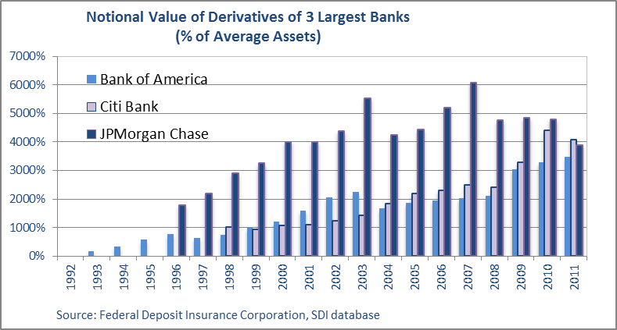
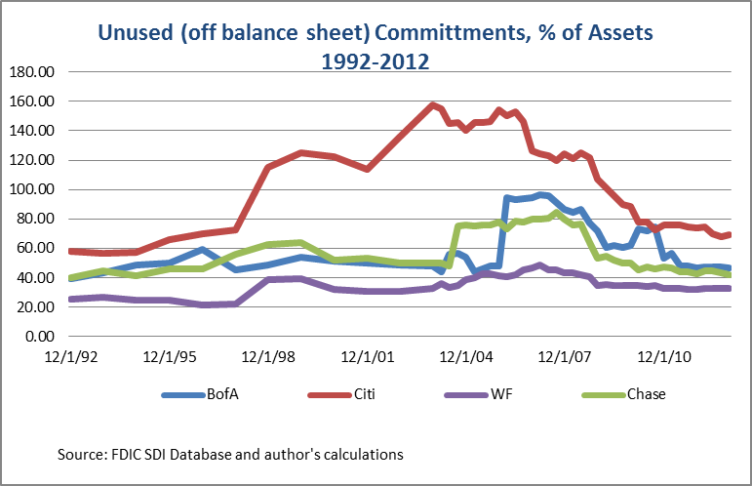
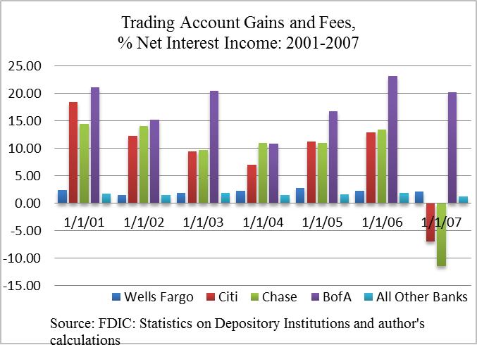
The Big 4: Banks or Shadow?

Slide 21
Can we put the Genie back in the bottle? Glass Steagall
Section 16 accorded regulated banks “all such incidental powers … necessary to carry on the business of banking” (FRB 1933, 396)→undermined separation
Liquidity creation was increasingly transferred from deposit taking by commercial banks subject to prudential regulation, to securitized structures that were exempt from reporting and regulation because they were considered capital market activities and (usually) exempt from even SEC oversight.
Kregel: If we re-segment, commercial banks must be profitable
Morgan Ricks: “term out” to eliminate competition from MMMF

Slide 22
A Modest Proposal
1. Banks lend directly to borrowers, and then service and hold them. There is no further public purpose served by selling loans or other assets to third parties, but there are substantial costs to government from regulation and supervision of those activities.
2. US banks cannot contract in LIBOR, an interest rate set externally with a large, subjective component and subject to manipulation. If not for indexing to LIBOR, the rates paid by US borrowers, including homeowners and businesses, would have come down as the Fed intended when it cut the fed funds rate.
3. Banks cannot have subsidiaries of any kind. No public purpose is served by allowing banks to hold assets 'off balance sheet.'
4. Banks should not be allowed to accept financial assets as collateral for loans. No public purpose is served by financial leverage.

Slide 23
Modest Proposal con’t
5. US Banks cannot lend off-shore. No national public purpose is served by allowing US banks to lend for foreign purposes.
6. Banks cannot buy (or sell) credit default insurance. The public purpose of banking as a public/private partnership is to underwrite and price risk. If a bank relies on credit default insurance it is transferring that pricing of risk to a third party, which is counter to the public purpose of banking.
7. Banks cannot engage in proprietary trading or any profit making ventures beyond basic lending. If the public sector wants to venture out of banking for some presumed public purpose it can be done through other outlets.
8. Use FDIC-approved credit models for evaluation of bank assets. Do not allow mark to market of bank assets. If there is a valid argument for marking a bank asset to market prices, that asset should not be a bank asset in the first place. The public purpose of banking is to facilitate loans based on credit analysis rather, than market valuation.

Slide 24
Conclusions for Reform: Gov’t Role
Reducing concentration plus retaining risk can reorient banks back to relationship banking
Role for gov’t to play in re-regulating and re-supervising
  There are no magic formulas (capital ratios, living wills, skin in the game)
Role for gov’t in direct provision of financial services
  Payments system
  Direct lending to serve public purpose
  Guarantees for public-private partnerships

